Slide 1


Activities at PPT Related to Fluid Dynamics
– A Short Review
Faculty of Mechanical Engineering Institute of Wood and Paper Technology, Professorship of Paper Technology
Harald Grossmann, Roland Zelm
Nancy, 13. October 2011

Slide 2
Content
Main research areas of PPT
Analysis and modelling of flocculation dynamics
Contribution of PPT to the CRAFT project “NODESZELOSS”
Design and assembling of an experimental equipment for pipe fittings
Dynamics of mixing processes
(Dynamic treatment of pulps with ultrasound)
Modification of an test rig for studying fluid dynamics and mixing phenomena

Slide 3
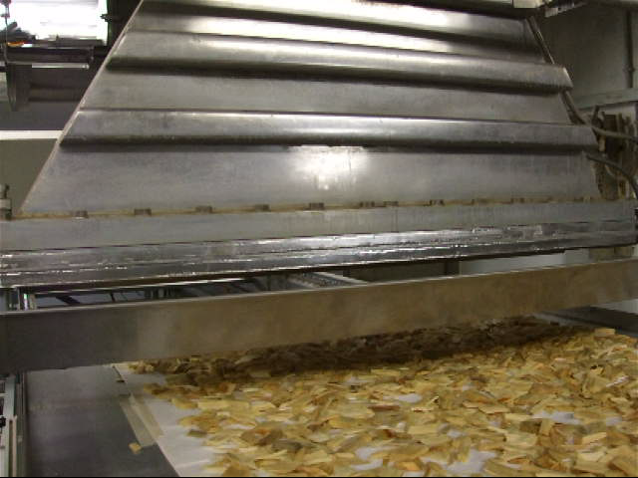
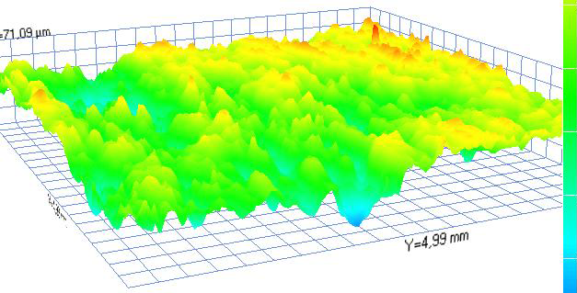
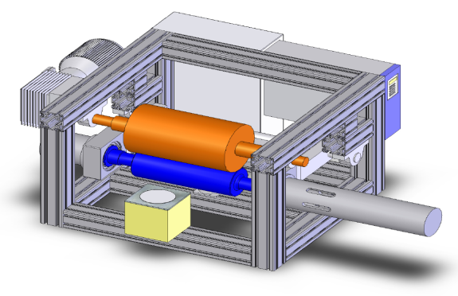
Main research areas
Resource efficiency
  (energy and raw materials)
Surface assessment and surface modification
  (Development and use of processes of surface assessment and surface modification of papers)
High power ultrasound applications
  in papermaking

Slide 4
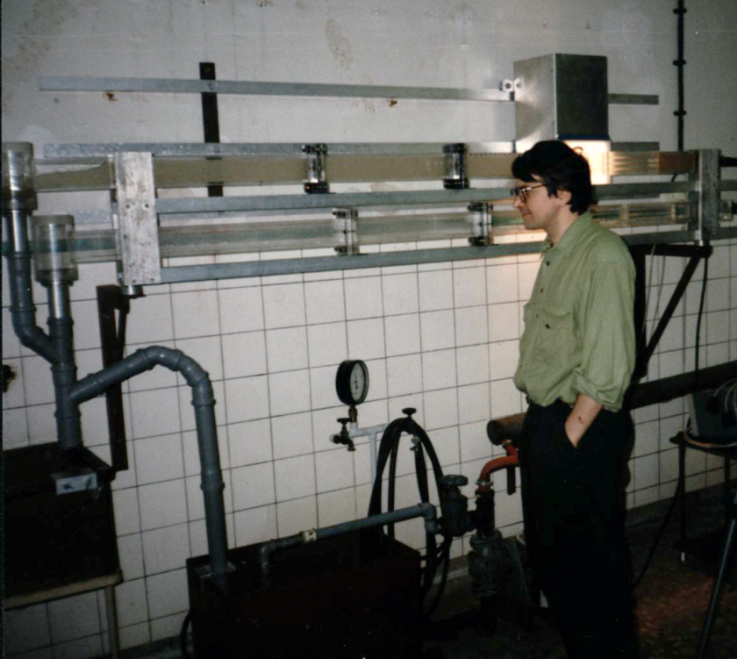
Flocculation dynamics
Ph. D. Thesis (Dr.-Ing. E. Davydenko)
Analysis and modelling of flocculation dynamics
Dynamics of mixing of flocculation aids and the flocculation of pulps
High speed camera
Retention analysis
Contribution to the development of a Computer Aided Process Simulation (CAPS) Software for educational purposes.

Slide 5
CRAFT project “NODESZELOSS”
OBJECTIVES
The general objective of this project was to develop a novel device which allowed the investigation of the behaviour of pulp suspensions, aiming at:
generating knowledge on pulp suspension flows. The goal was to determine the fluid dynamic behaviour of different pulp suspensions.
exploring the potential application of the new device for improving equipment design and avoiding oversizing.
exploring the potential application of the new device for the optimization of wet end chemistry.
This EU project was managed by UCM.

Slide 6
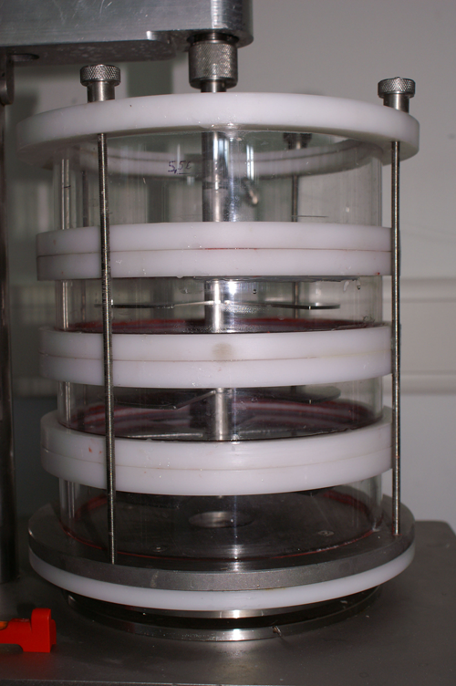
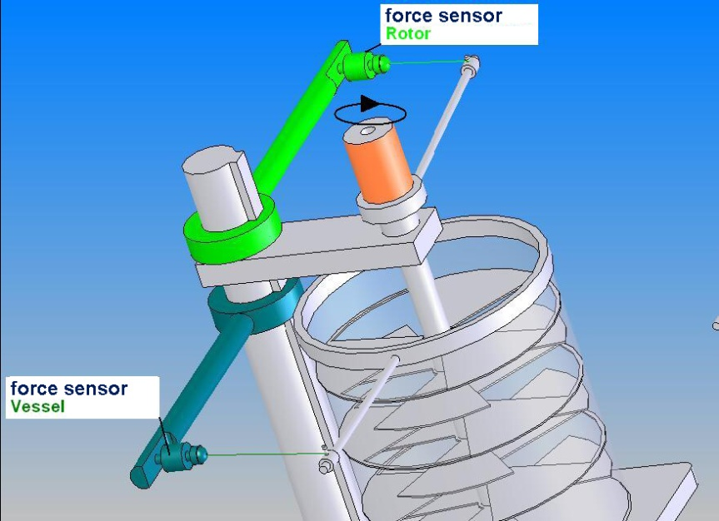
CRAFT project “NODESZELOSS”
Key features:
Characterization of the rheological behaviour of pulp suspensions as a function of shear stress
Separate measurement of the momentum of rotor and vessel
Design of the test rig which allows the simulation of pulp flow conditions typical for papermaking (distances between the horizontal plates and the rotor blades)
Prototype with new parts
Force sensors / load cells: 20 N

Slide 7
CRAFT project “NODESZELOSS”
Experimental programme
Influence of bleaching on the viscosity (rheological behaviour) of pulp suspensions
sample material: 3 industrial pulps from the same mill:
  unbleached softwood kraft pulp
  ECF softwood kraft pulp
  TCF softwood kraft pulp
Influence of peroxide bleaching (lab scale) on the rheological behaviour of as compared to the unbleached pulp as a function of
    the amount of peroxide
    stock consistency
    temperature
    bleaching time

Slide 8
CRAFT project “NODESZELOSS”

Slide 9
CRAFT project “NODESZELOSS”

Slide 10
CRAFT project “NODESZELOSS”

Slide 11
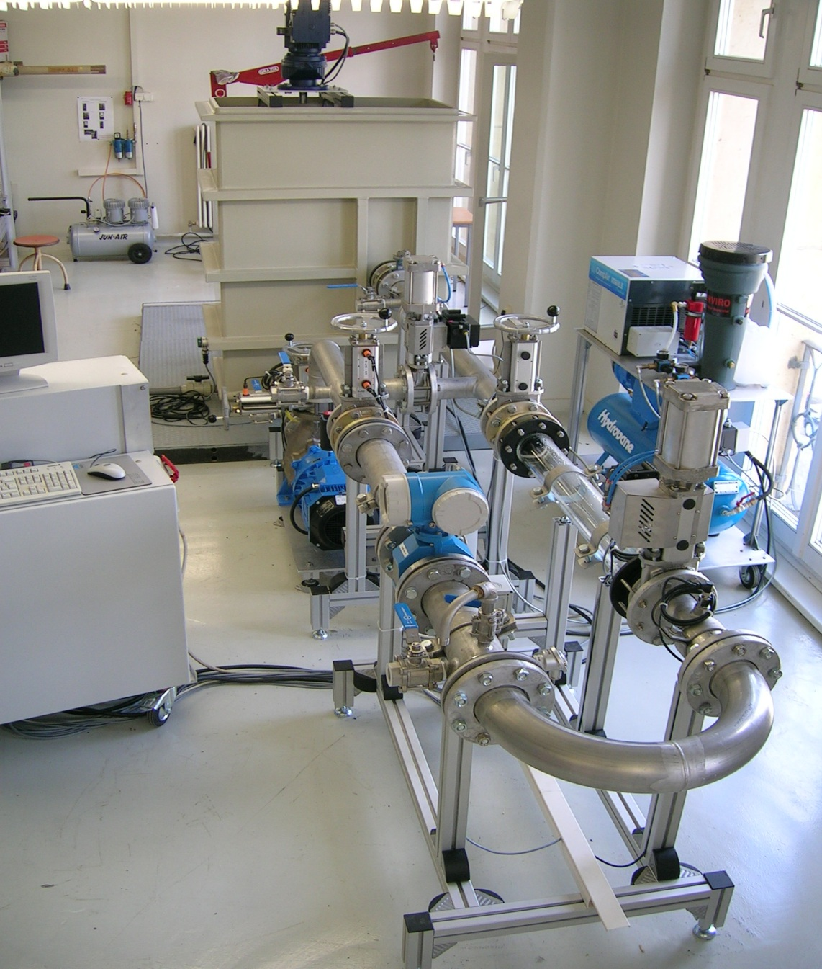
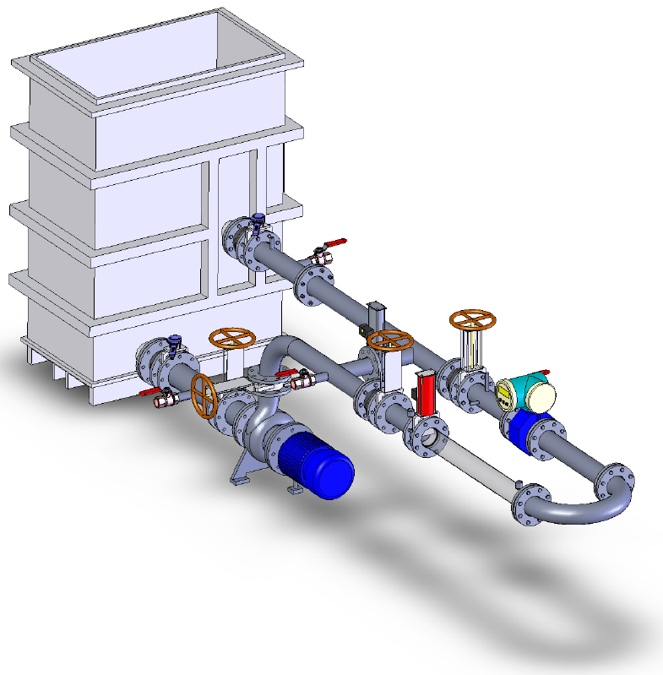
Experimental Equipment for fitting tests
Design and assembling of an experimental equipment for testing pipe fittings
Key figures:
Pipe DN100
Flow velocity 0,5 ... 5 m/s (max. 140 m³/h),
Consistency max. 3 %
Including stirrer
Online-Measurement of pressure drops, temperature, flux,
Pressurized air
Visualization of flow phenomena

Slide 12
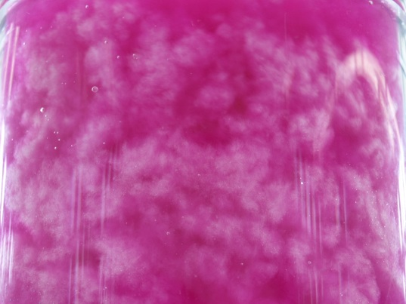
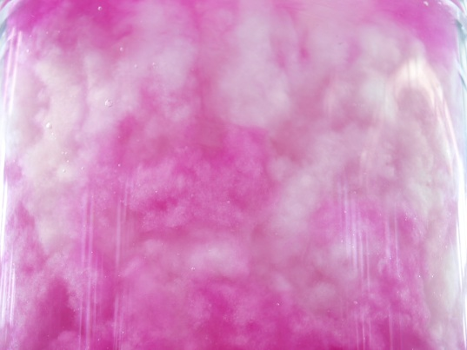

Examination of mixing processes
Background:
Energy savings through increased consistencies in stock preparation
Objective:
Optimization of mixing processes

Slide 13
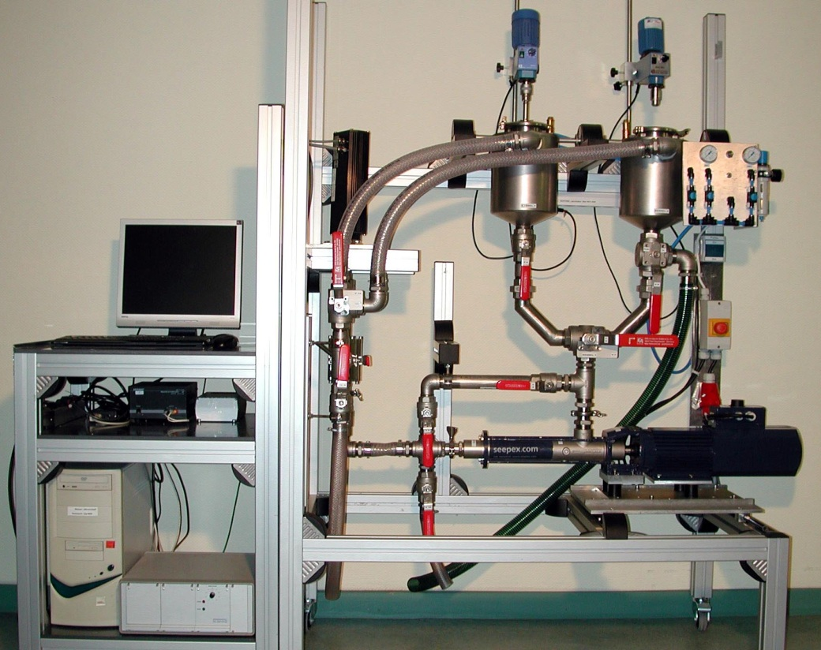
(Continuous ultrasound treatment of pulps)
Background:
Energy savings
Ultrasound treatment of pulps (i.e. support of refining)
Key figures:
Feed: 0,5 – 5 (15) l/min
Velocities:
  suction side:
  0,007 – 0,07 m/s
  pressure side:
  0,01 – 0,1 m/s

Slide 14
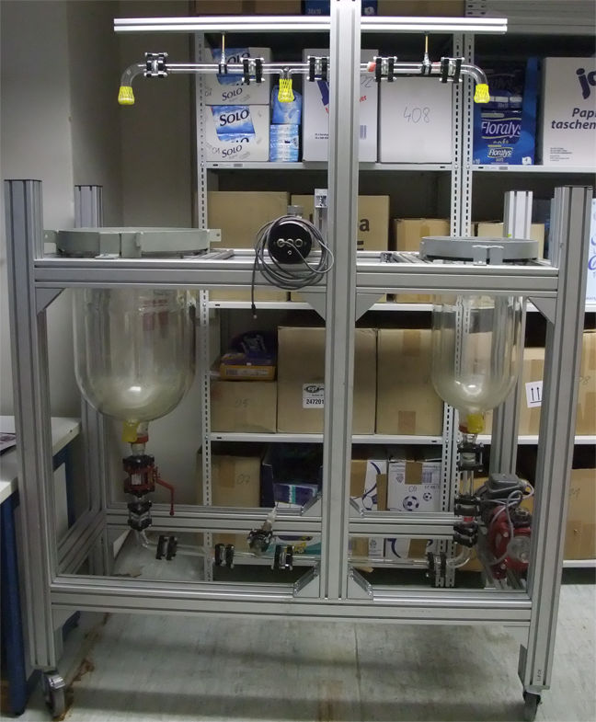
Modification of a test rig for fluid dynamics
Status:
Assembling of this equipment
First trials to get a closer look at mixing processes

Slide 15
Thanks to all partners for their contributions and their efforts.
Thank you for your attention.
The PPT is member of the cluster LignoSax.
Faculty of Mechanical Engineering Institute of Wood and Paper Technology, Professorship of Paper Technology

