Slide 1
Head loss and velocity profiles Martine RUEFF FP1005 Cost Meeting 13-14 October 2011
Laboratoire de génie des procédés papetiers
Grenoble INP - Pagora
www.pagora.grenoble-inp.fr

Slide 2
Objectives
To characterise pulp suspension flows at a low concentration (consistency below 4 %)
Head loss in straight pipes
Head loss in singularities
and to have a better insight of the suspension

Slide 3
Who
MSc students: Ph. Dietemann (2003), L. Salgueiro (2004)
PhD students: J.D. Bonfanti (1997), L. Salgueiro (2008)
Interns
Supervised by Martine Rueff Jean-Claude Roux

Slide 4
Test rigs
transparent pipes 120 / 80 / 50 mm
connections with smaller pipes, 17 to 40 mm, circular and rectangular cross- sections
max. flow rate 180 m³/h, 2 m³ storage tank
transparent pipe 65 mm
max. flow rate 120 m³/h,
1 m³ storage tank

Slide 5
Test rigs
Hydraulic headbox, width 50 cm, with transparent parts jet velocity up to 30 m/s 15 m³ tank

Slide 6
Equipment - sensors
Magnetic flow meters
Mass flow meter
Pressure sensors
Differential pressure sensors
Temperature sensors
Pulsed ultrasound Doppler velocimeter
High speed video camera / camcorder

Slide 7
Type of pulps
Almost any pulp received in bales or liquid form stock preparation facilities waste return to the paper machine
Focus on chemical pulps

Slide 8
Fibre suspension behaviour
ΔP/L , mbar/m
Water
100
80
60
40
20
10
80
60
40
20
10
5.0 %
4.5 %
4.0 %
3.5 %
3.0 %
2.5 %
2.0 %
1.5 %
80
mm
1 2 3 4 5 10 20 40 50 100 m³/h
0.2 0.3 0.5 0.8 1.2 2.0 3.0 5.0 m/s

Slide 9
Pulsed Ultrasonic Doppler Velocimetry

Slide 10
Pulsed Ultrasonic Doppler Velocimetry
Parameters
f_{e} : transducer (size of particles)
θ : transducer angle
T_{prf} : time interval between two pulses
Filter coefficients
Other factors
Refractive index of pipe wall

Slide 11
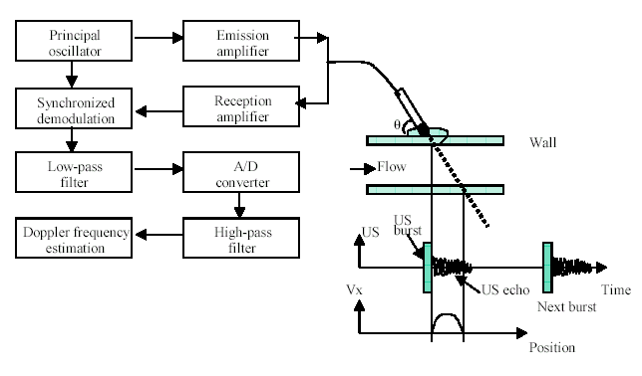
Pulsed Ultrasonic Doppler Velocimetry

Slide 12
Pulp suspension and experimental conditions
Bleached softwood pulp (maritime pine + traces of fir)
34 °SR
Length-weighted average length: 0.69 mm
Fibre coarseness: 0.226 mg/m
Consistencies: 0.47 %, 1.0 % and 2.1 %
Velocities : up to 7 m/s

Slide 13
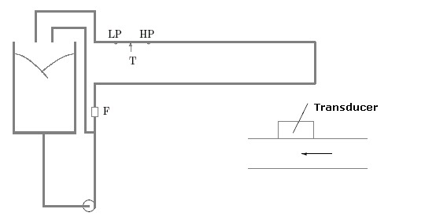
Experimental loop
Electromagnetic flow meter : 0-180 m³/h
Differential pressure sensor : 0-50 mbar

Slide 14
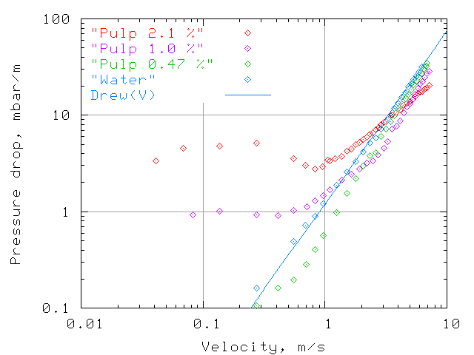
Pressure drop curves

Slide 15
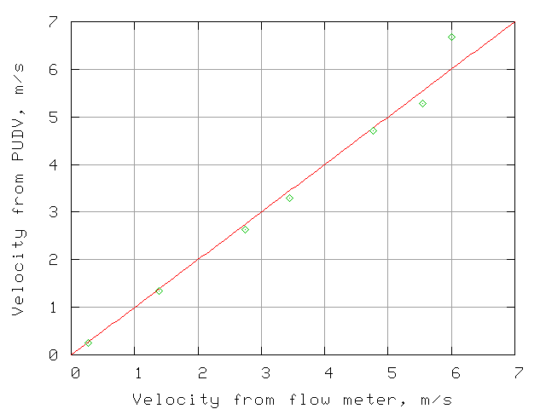
Analysis of the velocity profiles

Slide 16
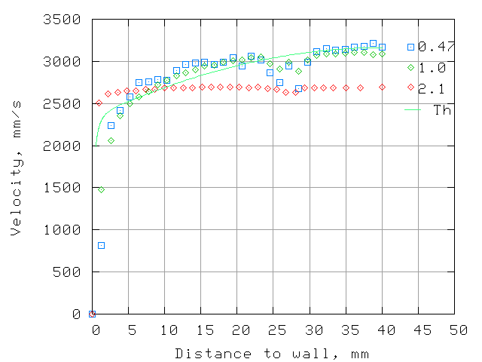
Velocity profiles at 2.6 m/s

Slide 17
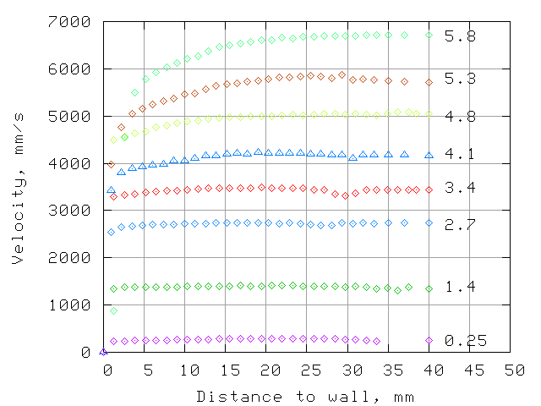
Velocity profiles for 2.1 % consistency

Slide 18
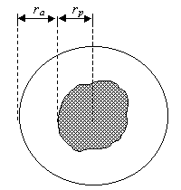
Volume fraction of “fluidised” suspension
Velocity
r
R
p
Distance to centreline

Slide 19
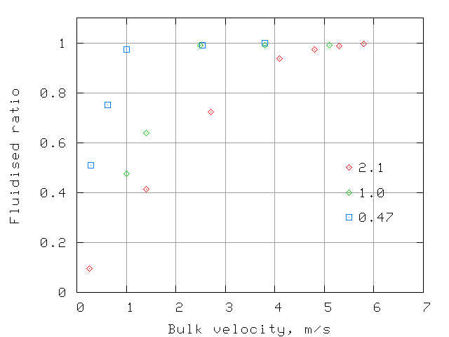
Volume fraction of “fluidised” suspension

Slide 20
Video images
Consistency, % 0.47 1.0 2.1
Beginning of “fluidisation”, m/s 0.2-0.7 1.4-2.8 1.4-2.8
Limit velocity for large aggregates, m/s 0.2-0.7 1.4-2.8 2.8
Apparition of relative motion, m/s / 2.1-4.1 4.1

Slide 21
Conclusion
PUDV: non intrusive technique
Enabled us to explore a wide range of velocities and consistencies
From the velocities profiles, determination of:
plug size
volume fraction of fluidised suspension
disruptive shear stress using pressure loss measurements

Slide 22
Conclusion
The suspension was not totally homogeneous when drag reduction occurred
Video sequences showed the presence of large aggregates near the wall at relatively high velocities.

