Slide 1

A Novel laboratory scale pipe rheometry
J. Salmela, S. Haavisto, J. Liukkonen
A. Jäsberg and A. Koponen
Technical Research Centre of Finland
COST Action FP 1005, Nancy 13-14 October 2011

Slide 2
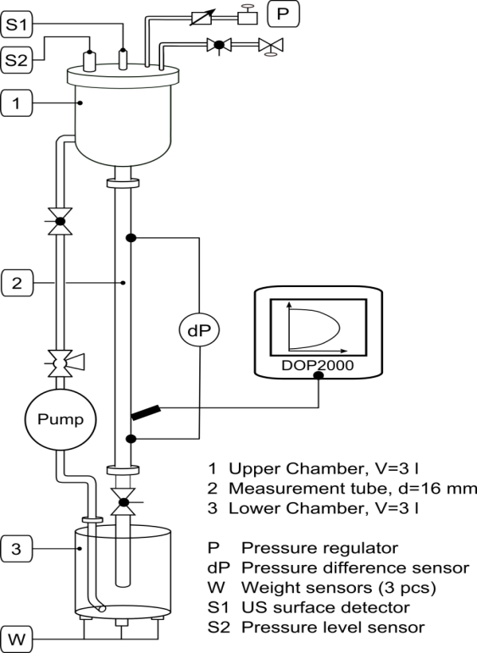
Motivation / Goal
COST Action FP 1005, Nancy 13-14 October 2011
Characterize rheological behavior of Microfibrillated cellulose suspensions
  Rheology and composition of Microfibrillated Cellulose (MFC) is very complex
Develop a well controlled flow environment
  Reliable
  Repeatable
  Scalable
  Low volumes
  High dynamic and viscosity range
  Allows flocculation
Notes:
Still many MFC grades are difficult to get in large volumes
MFC Pumping experiments in large scale are difficult
Traditional rheometers may be affected by flocculation
Results easy to interpret to processes

Slide 3
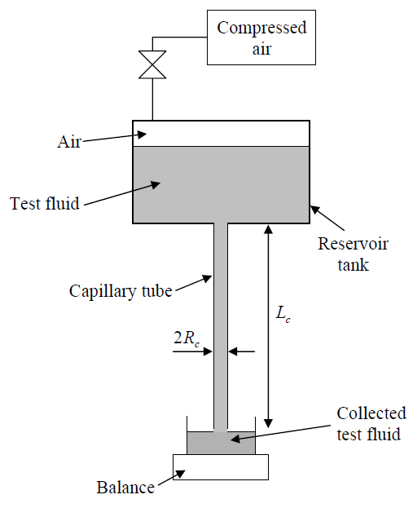
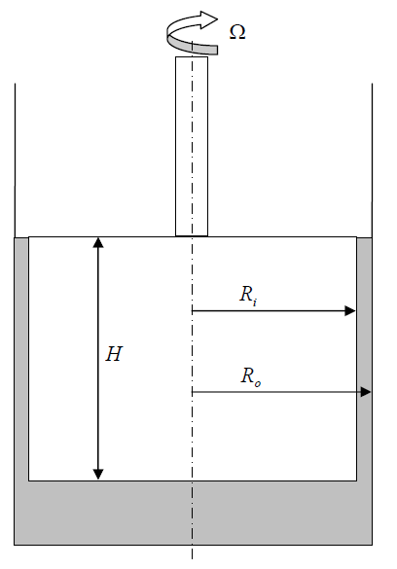
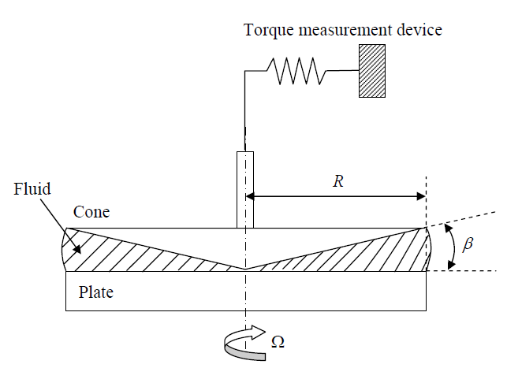
Background
COST Action FP 1005, Nancy 13-14 October 2011
Rheology – a science of flow and deformation of matter
Most of traditional rheometers don’t work for flocculating or granular suspensions
In traditional rheology true velocity profile of the flow is not used
  This is compensated by using assumptions
Notes:
Mitä oletuksia käytetään?

Slide 4
Methods
COST Action FP 1005, Nancy 13-14 October 2011
Rheology in Pipe Flow:

Slide 5
Apparent viscosity
COST Action FP 1005, Nancy 13-14 October 2011
Capillary rheometer (Pipe Flow)
  Assuming laminar Newtonian flow
Shear rate
Shear stress
Apparent viscosity

Slide 6
Local viscosity
UVP-PD + OCT Technique
COST Action FP 1005, Nancy 13-14 October 2011
Ultrasound Velocity Profiling, Optical Coherence Tomography and Pressure Difference
US Probe
UVP
Z
V
OCT
Z
V
x=at
Target particle

Slide 7
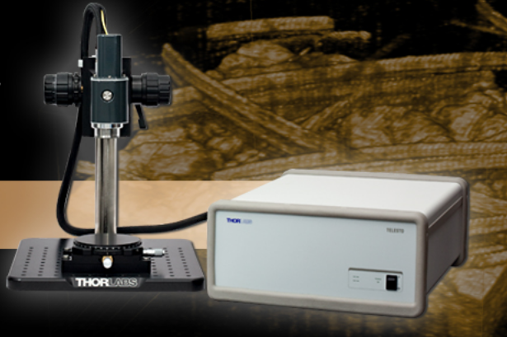
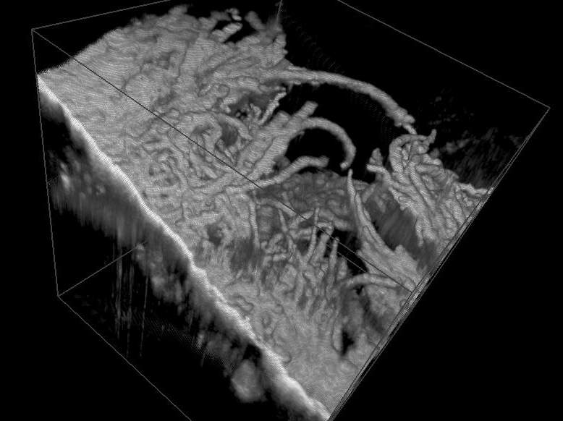
OCT

Slide 8
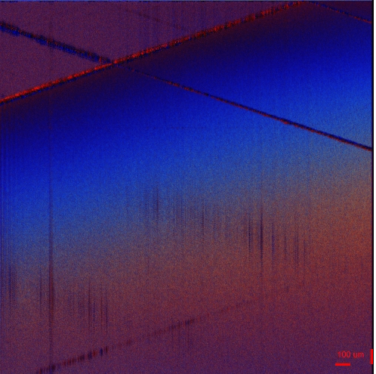
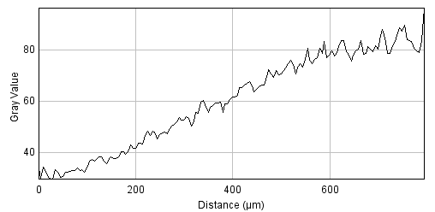
OCT

Slide 9
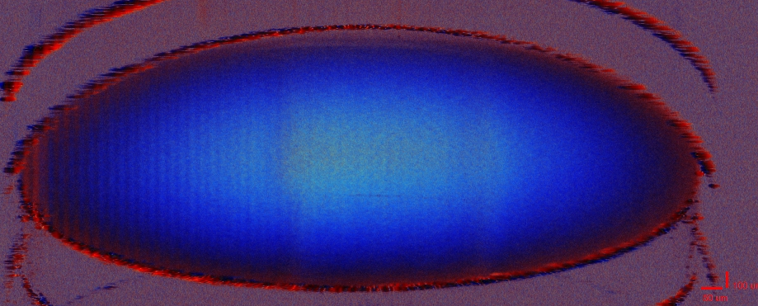
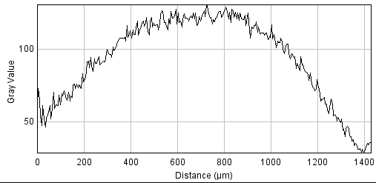
OCT

Slide 10
Local viscosity
Data analysis
COST Action FP 1005, Nancy 13-14 October 2011
Calculation of local viscosity
Maximum
shear stress
Plug flow
region
Slip
velocity
Local
shear rate
Boundary
layer
Zero
shear stress

Slide 11
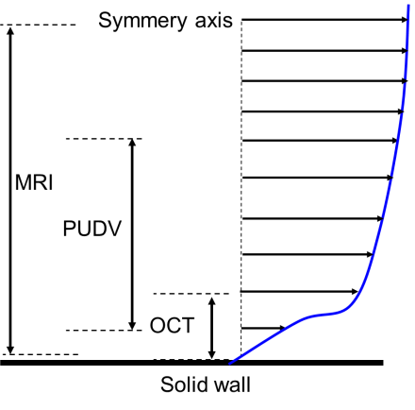
What we need to parameterize the whole velocity profile?
Currently our groups have acces to non invasive measurement methods that enables direct measurement of the whole velocity profile of dence suspensions
Figure 6. Example of velocity profile and usability of different measurement methods.

Slide 12
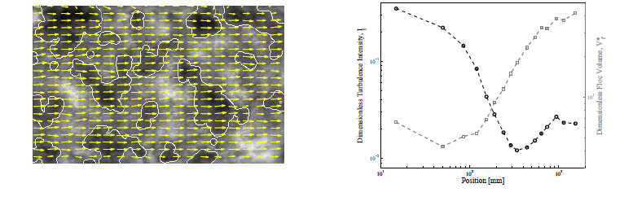
What we already have?
Floc size for different furnish and for different geometries
  Minimum floc size (after sudden pipe expansion)
  Location of minimum floc size (after sudden pipe expansion)
  Reflocculation rate

Slide 13
Velocity Field Analysis
Average Flow Field
Instantaneous Flow Field
Image 1
Image 2
Two Consecutive Images
Notes:
Explain:
Example images
Flow geometry
Pine suspension
Flocs dark and edges empasized
Displacement ~0.5 mm
Time btw. pulses 300 us
Instantaneous flow field
Average flow field

Slide 14
1
Turbulent Intensity I_{t}
2
Dimensionless Floc Volume, V*_{f}
3
1
2
3
Pulsed Light Source
Notes:
Explain:
Graph (axis)
Camera
Light source
Two images
Instantaneous flow field
Average flow field
Change of position

Slide 15
What we get from accurate velocity profile maesurement?
(Only direct measurements no assumptions needed)
Shear viscosity
Yield stress (floc strength)
Lubrication layer
  Drag reduction
  Turbulence dissipation rate
Size of plug flow region
*

Slide 16
What we need to do?
Definition of test geometries
  Sudden pipe contraction / expansion?
Validation of measurements and models using well known fluids
  Water
  Carbopol?
Definition of suspensions
  Birch
  Pine
  MFC?
Co-Operation

Slide 17
Training school 2012
Preliminary schedule
  KTH
  Boat trip to Finland and train to Jyväskylä ☺
  Lectures
    Professor Risto Myllylä (University of Oulu): Principles of Optical Coherence Tomography
    Professor Markku Kataja (University of Jyväskylä): Use of X-Ray μ and nano Tomography to study structure and flow in porous media
  Hands on lab tour:
    Laboratory scale pipe rheometry: Use of OCT and UDV
    Optical measurement methods:
      High speed video imaging
      Floc size evolution measurements

