Slide 1
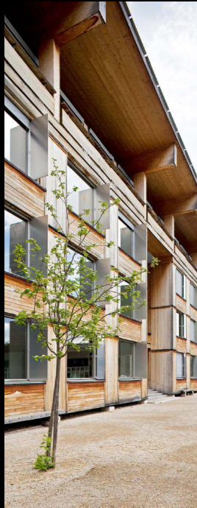

COST Action FP1005
Working Group Meeting (WG 3)
Nancy, 13/10/2011
Bern University of Applied Sciences
Architecture, Wood and Civil Engineering
Two sectors, same questions:
Flow simulations as tools in paper and wood-based panel manufacture
Heiko Thoemen

Slide 2
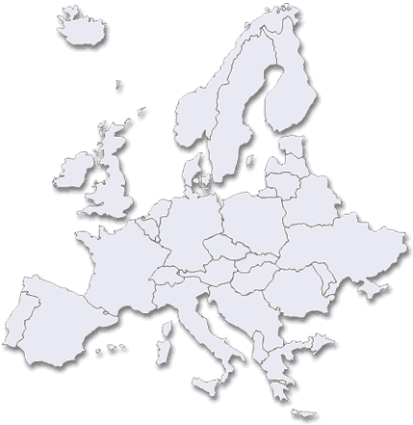
Bern University of Applied Sciences
Architecture, Wood and Civil Engineering

Slide 3
Bern University of Applied Sciences
Architecture, Wood and Civil Engineering
Education
Higher Technical Schools
Bachelor Programs
Master Programs
Postgraduate Courses
Research and development
About 100 full-time equivalent employees
One field of research: Wood-based composites process technology, process modelling

Slide 4
Background of COST project proposal
Considerable similarities between hot-pressing process and calendering of paper sheets
  Wood fibers as raw material
  Micro-structure of material
  Material compression at elevated temperatures
  Inhomogeneous cross-sectional density distribution
  Moisture content below fiber saturation
Advanced models available in the wood-based composite sector
Important features are missing in today's calendering models
  Phase change of water
  Convective heat transfer inside the web
  Material compaction
  Development of cross-sectional density profile
Great potential for facilitating synergies and scientific exchange

Slide 5
Motivation for modelling the calendering process
Understand fundamentals of paper calendering
Further improve surface quality without reducing paper or board thickness
Develop strategies to reduce energy consumption

Slide 6
Objective of COST Action FP1005
"Promote and disseminate validated computer modeling and simulation techniques in papermaking industry. These modern numerical tools, allowing for deep insight into the physics of the momentum, mass and heat transfer processes, provide new possibilities for design engineers resulting in innovative solutions unavailable with already utilized methodologies"
Memorandum of Understanding, COST Action FP1005

Slide 7
Content
1. Process comparison
2. Modelling hot pressing of MDF*
3. Model adaptation to calendering
* MDF = Medium Density Fiberboard

Slide 8
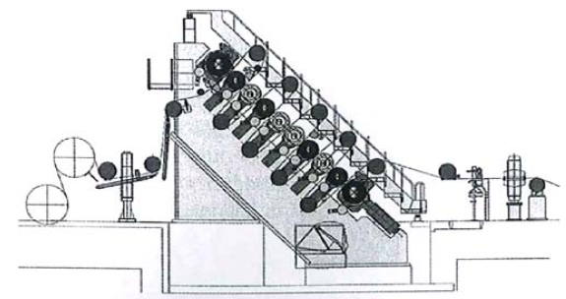
Calenders
Process comparison
Janus calender

Slide 9
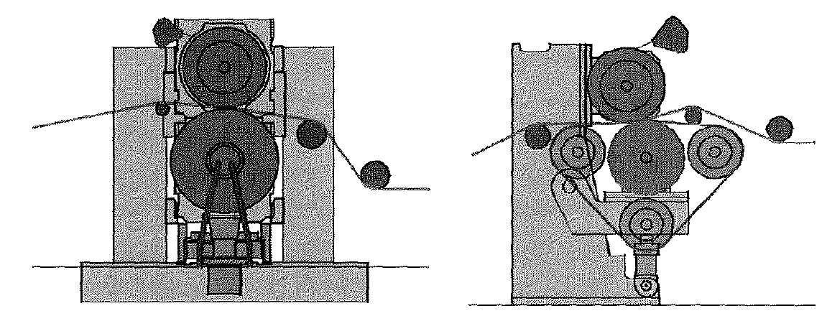
Calenders (long nip)
Process comparison
Shoe calender
Belt calender

Slide 10
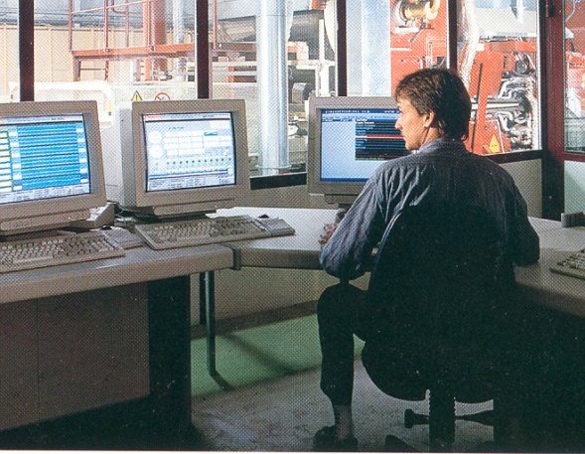
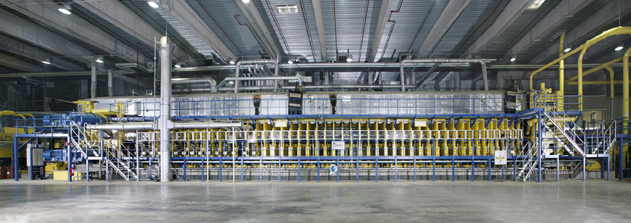
MDF hot press
Process comparison
Forming line
Hot press

Slide 11
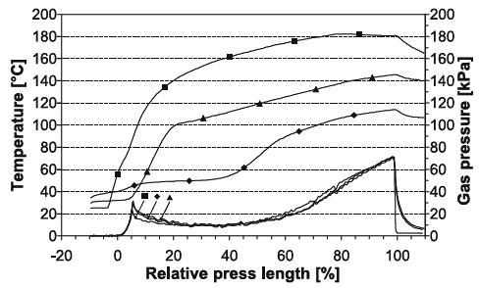
MDF hot press
Process comparison
(Graphic refers to particleboard, not MDF)

Slide 12
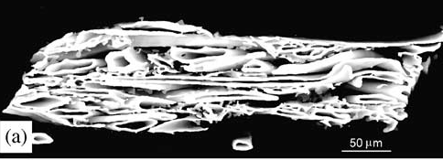
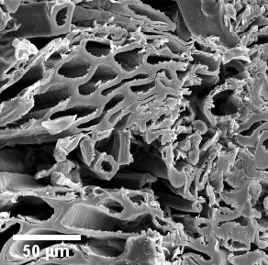
Material structure
Process comparison
MDF
Newsprint Paper
1200
1000
Density (kg/m³)
800
600
400
Source: Christine Antoine et al. (2002). 3D images of paper obtained by phase-contrast X-ray microtomography: image quality and binarisation
0 5 10 15 20
Cross-sectional position (mm)

Slide 13
Challenging differences
Process comparison
Thickness of material
Duration of temperature and pressure exposure
Pre-treatment of paper sheet / fibres before calendering

Slide 14
Content
1. Process comparison
2. Modelling hot pressing of MDF
3. Model adaptation to calendering

Slide 15
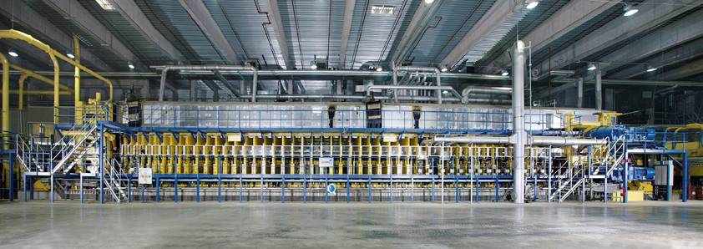

Hot pressing
MDF modelling
?
Metso Panelboard

Slide 16
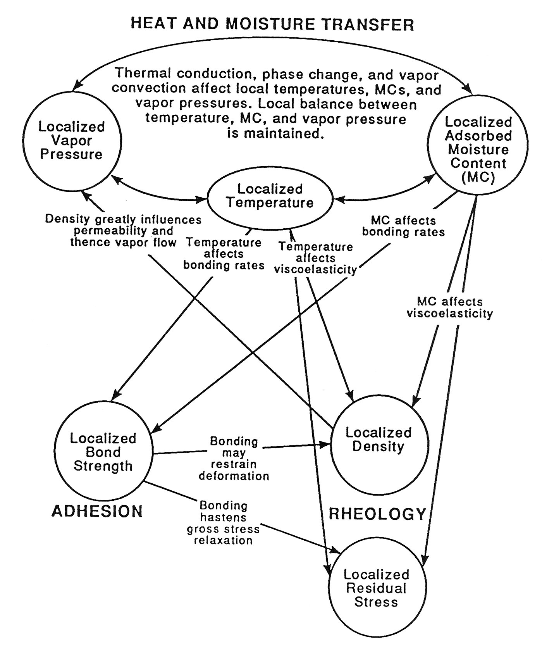
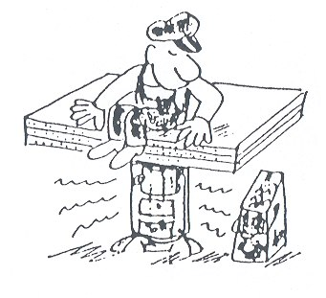
Fundamental mechanisms
MDF modelling
Source: Humphrey 1994

Slide 17
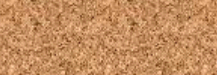
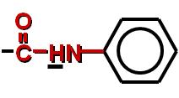
Fundamental mechanisms
MDF modelling
HEAT AND MOISTURE TRANSFER
ADHESION
RHEOLOGY
Source: Humphrey 1994

Slide 18
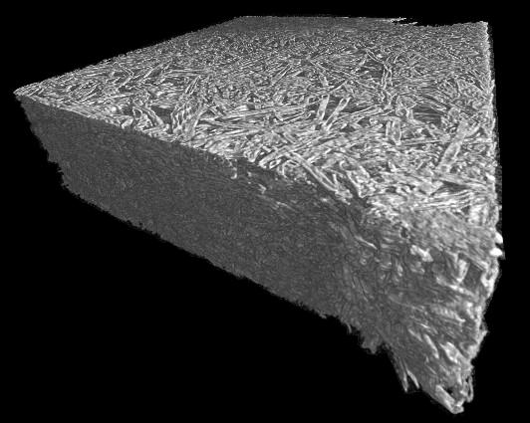

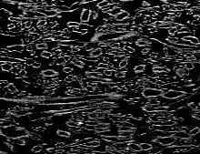
Heat and moisture transfer
MDF modelling
Mat structure
?
Microtomography
of an MDF sample
Intra-fiber voids (= lumens)
Inter-fiber voids (= between fibers)

Slide 19
Heat and moisture transfer
MDF modelling
Basic transfer mechanisms
Fibre mat
heat
conduction
Heating platen
or steel belt
> 200°C

Slide 20
Heat and moisture transfer
MDF modelling
Basic transfer mechanisms
heat
conduction
> 200°C
evaporation
of water

Slide 21
Heat and moisture transfer
MDF modelling
Basic transfer mechanisms
heat
conduction
convection
> 200°C
evaporation
of water

Slide 22
Heat and moisture transfer
MDF modelling
Basic transfer mechanisms
condensation
of water vapor
heat
conduction
gas and heat
convection
> 200°C
evaporation
of water

Slide 23
Heat and moisture transfer
MDF modelling
Mass conservation
(gas flux)
(compression)
(temperature)
(phase change)
(gas pressure)
Energy conservation (simplified)
i Index für Gaskomponente
j Massenstrom (kg m⁻² s⁻¹)
q Kond. Wärmestrom (J m⁻² s⁻¹)
p Gasdruck (Pa)
T Temperatur (°C)
t Zeit (s)
ρ Dichte (kg m⁻³)
φ Porenanteil (-)
c Wärmekapazität (J kg⁻¹ K⁻¹)
M Molmasse (kg mol⁻¹)
r Umwandlungsrate (kg m⁻³ s⁻¹)
H_{v} Umwandlungswärme (J kg⁻¹)
R Univ. Gaskonstante (J mol⁻¹ K⁻¹)
(conduction)
(phase change)
(temperature)
Thoemen, H., und P. E. Humphrey (2006): Holz Roh- Werkst. 64(1): 1-10

Slide 24
Fundamental mechanisms
MDF modelling
Deformation
processes
Development of
internal stresses
RHEOLOGY
Source: Humphrey 1994

Slide 25
Rheology
MDF modelling
Density profile
Density profile

Slide 26
Rheology
MDF modelling
Effect of temperature and moisture on densification
T₁ = 110°C
u₁ = 10%
σ = 3 N/mm²
ρ = 820
T₂ = 20°C
u₂ = 5%
ρ = 470
(no load)
(with load)

Slide 27
Rheology
MDF modelling
Effect of temperature and moisture on densification
Load
T₁ = 110°C
u₁ = 10%
σ = 3 N/mm²
σ = 3 N/mm²
ρ = 820
T₂ = 20°C
u₂ = 5%
T₂ = 20°C
u₂ = 5%
ρ = 470
ρ = 470
Local
conditions
(no load)
(with load)
Local
density

Slide 28
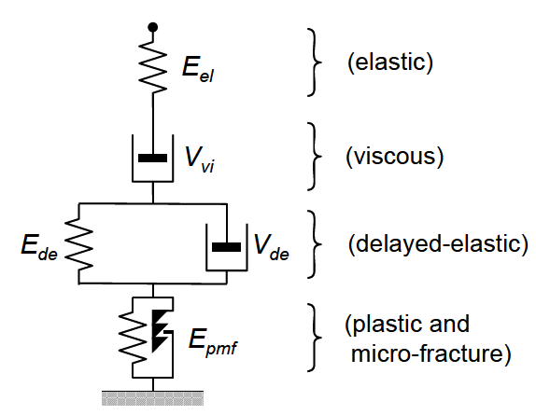
Rheology
MDF modelling
Extended
Burgers Model
E and V = f (temperature, moisture content, density)

Slide 29
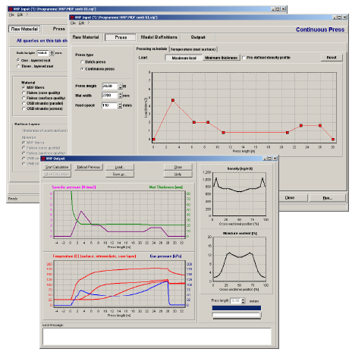
Numerical solution & implementation
MDF modelling
Modified finite volume approach (constitutive flux equations are coupled by local energy and mass balances)
3D flow computations, 1D densification model
Implicit approach for cross-sectional flow computations to avoid numerical instabilities
In-house programming code is
written in ANSI C
Commercialized as simulation
platform Virtual Hot Press

Slide 30
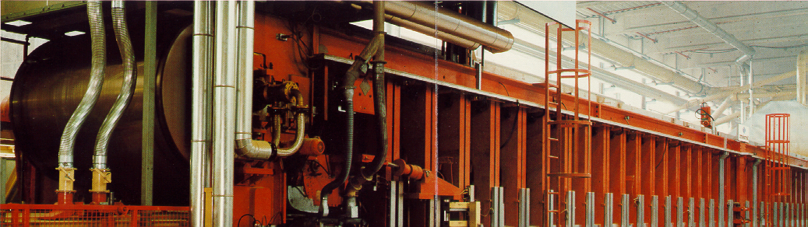
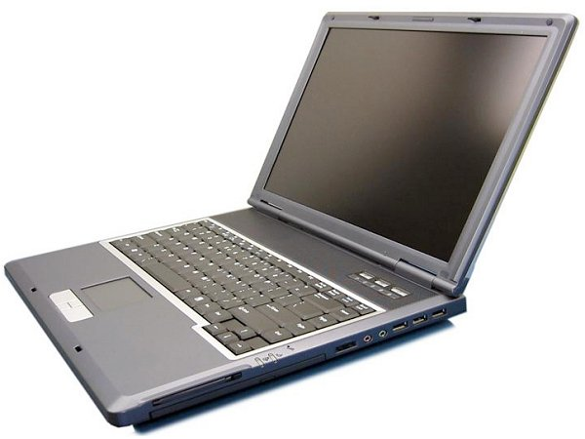
Material property data
Real System
Prediction
Modelling
Material
properties
Execution
Implemen-
tation
Model
Software

Slide 31
Temperature development
(simulation and experiment)
MDF modelling
Surface layer
Temperature (°C)
Core layer
Measurement
Simulation
Time (s)

Slide 32
Gas pressure development
(simulation and experiment)
MDF modelling
Trial 1
140
Measurement
Simulation
100
Gas pressure (kPa)
Trial 2
140
100
Trial 3
140
100
0
200
400
600
800
1000
Time (s)

Slide 33
Content
1. Process comparison
2. Modelling hot pressing of MDF
3. Model adaptation to calendering

Slide 34
Selected key assumptions of hot-pressing model
Assumption 1: The material is macroscopically homogeneous
Daryc's and Fourier's law, macroscopic flow coefficients
Approach is valid for MDF and even oriented strandboard (OSB), probably also for thick paper and cardboard
➔ Assumption will be maintained

Slide 35
Selected key assumptions of hot-pressing model
Assumption 2: Water exists in bound and vapor states; free water is not present
Also valid for calendering
➔ Assumption will be maintained

Slide 36
Selected key assumptions of hot-pressing model
Assumption 3: Inside the fiber network heat is transferred by convection (i.e. gas flow in combination with phase change) and conduction
Phase change and vapor convection is likely to occur also during calendering
➔ Assumption will be maintained

Slide 37
Selected key assumptions of hot-pressing model
Assumption 4: Local equilibrium between gas phase and cell walls is reached instantaneously
Good approximation for MDF
Probably critical for calendering (very short time of heat exposure)
➔ Assumption will be critically evaluated, routine to compute delayed water uptake my be implemented

Slide 38
Selected key assumptions of hot-pressing model
Assumption 5: Perfect heat transfer between steel belt and panel surface
Good approximation for MDF
In calendering, heat transfer resistance is likely to exist
➔ Coefficient to account for imperfect heat transfer at paper surface will be introduced

Slide 39
Simplifications
Material compaction will not be computed (possibly topic for follow-up project)

Slide 40
Tasks / Working packages
Model adaptation
Measurement of flow properties
Thermal conductivity
Gas permeability (only in z-direction)
Model validation: Measurement of cross-sectional temperature development in thick paper
Will be done at laboratory of Voith Paper (Ravensburg, Germany)
Different paper types
Sensitivity analysis
Effects of
  material property data and
  process parameters
on the heating pattern during paper calendering will be evaluated

Slide 41
Summary
Similarity of hot-pressing process (MDF) and calendering process (paper sheets)
At BFH-AHB: Hot-pressing model is available (Virtual Hot Press, VHP), will be adapted
Measurements of the cross-sectional temperature distribution during calendering has not been reported yet.
Great potential for learning from other sectors

Slide 42
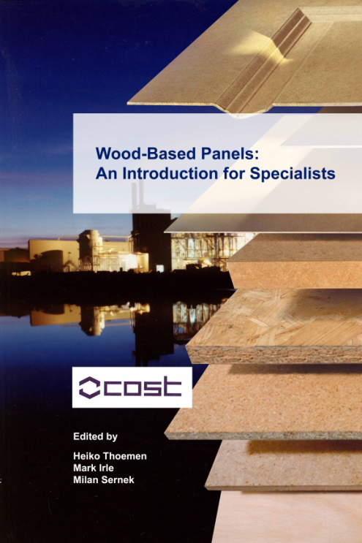
Thank You

