Slide 1
Joint 4th SIG43 –FP1005 Workshop on
Fiber Suspension Flow Modelling
Slip Velocity of Rigid Fibers
in Wall-Bounded Turbulence
L. Zhao¹, C. Marchioli², H. Andersson¹
¹Department of Energy and Process Engineering, NTNU
²Centro Interdipartimentale di Fluidodinamica e Idraulica, University of Udine
PFI, Trondheim, October 24-26, 2012

Slide 2
Motivation of the Study:
Why are we looking at the slip velocity?
Slip velocity is a crucial variable in:
Euler-Lagrange simulations:
One-way coupling: determines the drag experienced by fibers
Two-way coupling: determines
reaction force from fibers on fluid
Two-fluid modeling of particle-laden flows
Modeling SGS fiber dynamics in LES flow fields
Crossing trajectory effects on time decorrelation tensor of u
v
u
u: fluid velocity “seen”
v: fiber velocity
∆u=u-v: slip velocity
Aim of this study: statistical characterization of ∆u at
varying fiber inertia and elongation

Slide 3
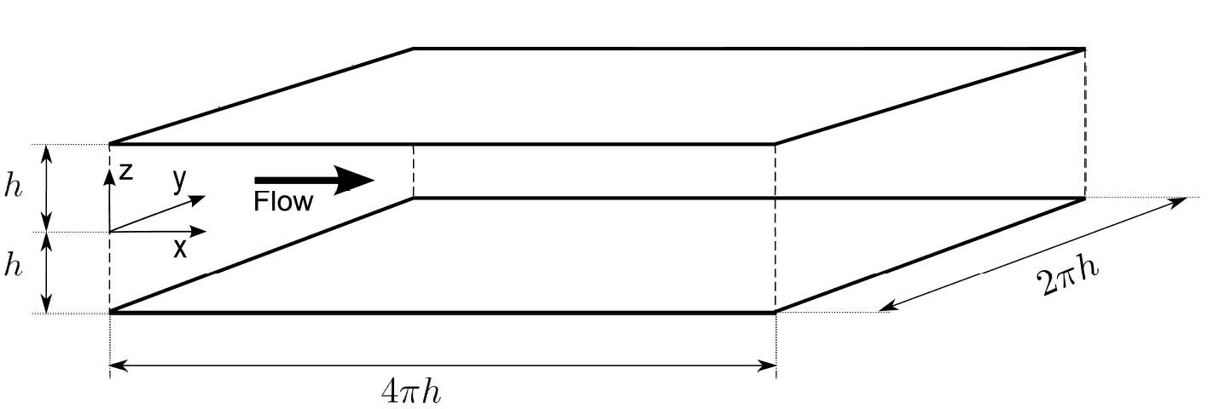
Methodology - Carrier Fluid
DNS of turbulent channel flow @ Re_{τ}=u_{τ} h/ν=150, 180, 300
Pseudo-Spectral method: Fourier modes in x and y, Chebyschev modes in z.
Examples: flow of air at 1.8 m/s in a 4 cm high channel
flow of water at 3.8 m/s in a 0.5 cm high channel

Slide 4
Methodology - Fibers
Fibers are modelled as prolate ellipsoidal particles.
Simplifying assumptions: dilute flow, one-way coupling, Stokes flow (ReP<1 ), pointwise particles (particle size is smaller than the smallest flow scale).
200,000 fibers tracked, random initial position and orientation, linear and angular velocities equal to those of the fluid at fiber’s location.
Periodicity in x ed y, elastic rebound at the wall and conservation of angular momentum.
Lagrangian particle tracking.

Slide 5
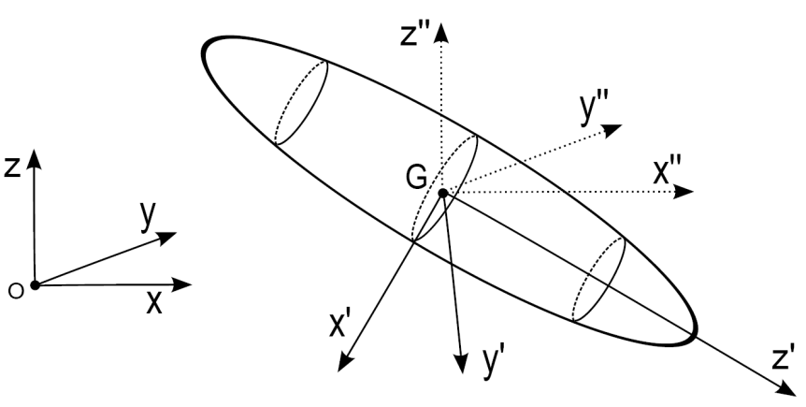
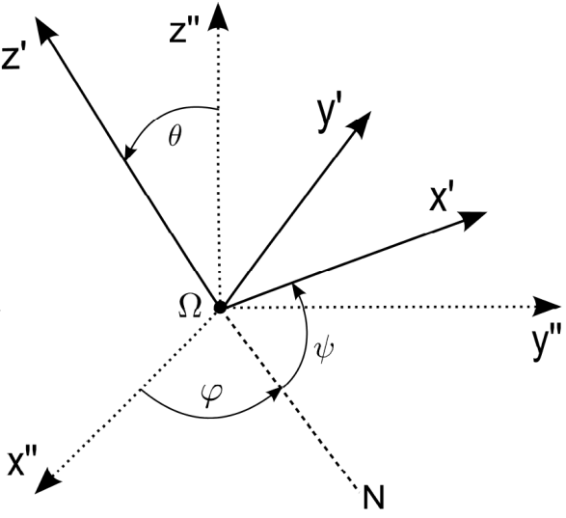
Methodology – Fiber Kinematics
Kinematics: described by (1) position of the fiber center
of mass and (2) fiber orientation.
x_{G}, y_{G}, z_{G}
3 frames of reference (to define orientation)
Euler angles: φ, ψ, θ (singularity problems)
Euler parameters: e₀, e₁, e₂, e₃
Rotation matrix:
, …

Slide 6
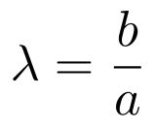
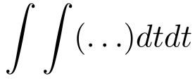
Methodology – Fiber Dynamics
Rotational dynamics: Euler equations with Jeffery moments.
Euler Equations: (2nd cardinal law)
(in the particle frame)
Jeffery moments:
(Jeffery, 1922)
Aspect Ratio
Hence:
Euler equations with Jeffery couples
e0, e1, e2, e3
(Euler parameters)

Slide 7
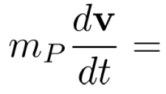
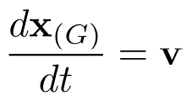
Methodology – Fiber Dynamics
Translational Dynamics: hydrodynamic resistance (Brenner, 1963).
First cardinal law:
(inertia and drag only!!)
Brenner’s law: (form drag and skin drag)
(in the fiber frame)
Resistance Tensor
In the inertial (Eulerian) frame:
,
(via numerical integration)
Once fiber orientation is known, fiber translational motion can be computed!

Slide 8
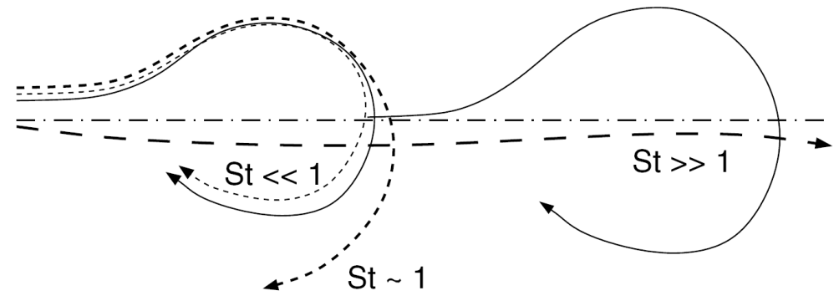
Relevant Parameters
and Summary of the Simulations
The physics of turbulent fiber dispersion
is determined by a small set of parameters
Aspect ratio: (chosen values: λ=1.001, 3, 10, 50)
Stokes number: (chosen values: τ⁺=1, 5, 30, 100)
τ >> 1: large inertia (“stones”)
τ << 1 : small inertia (tracers)
τ ~ 1 : preferential (selective)
response to flow structures
+
+
+
Input parameters: S, τ , λ
+
Specific density:

Slide 9
“Cartoon” of
fiber ’s elongation
λ=1.001 (spherical particle)
λ=3
λ=10
λ=50 (elongated “spaghetti-like” fiber)

Slide 10
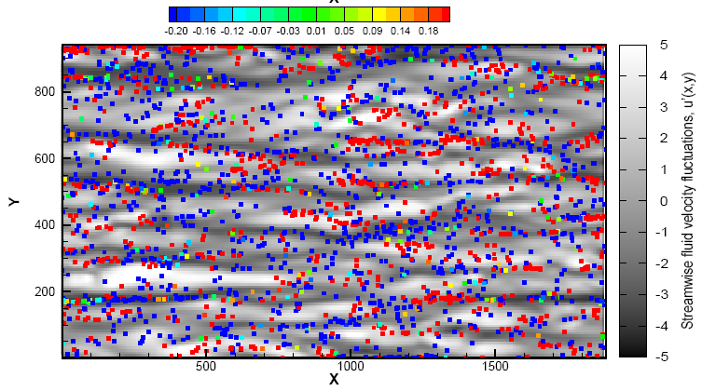
Results - Non-Homogeneity of
Near-Wall Fiber Preferential Distribution
Top view: fibers accumulate in near-wall fluid Low-Speed Streaks (LSS)
Slip velocity at fiber position:
Sample snapshot for τ⁺=30, λ=50 fibers

Slide 11
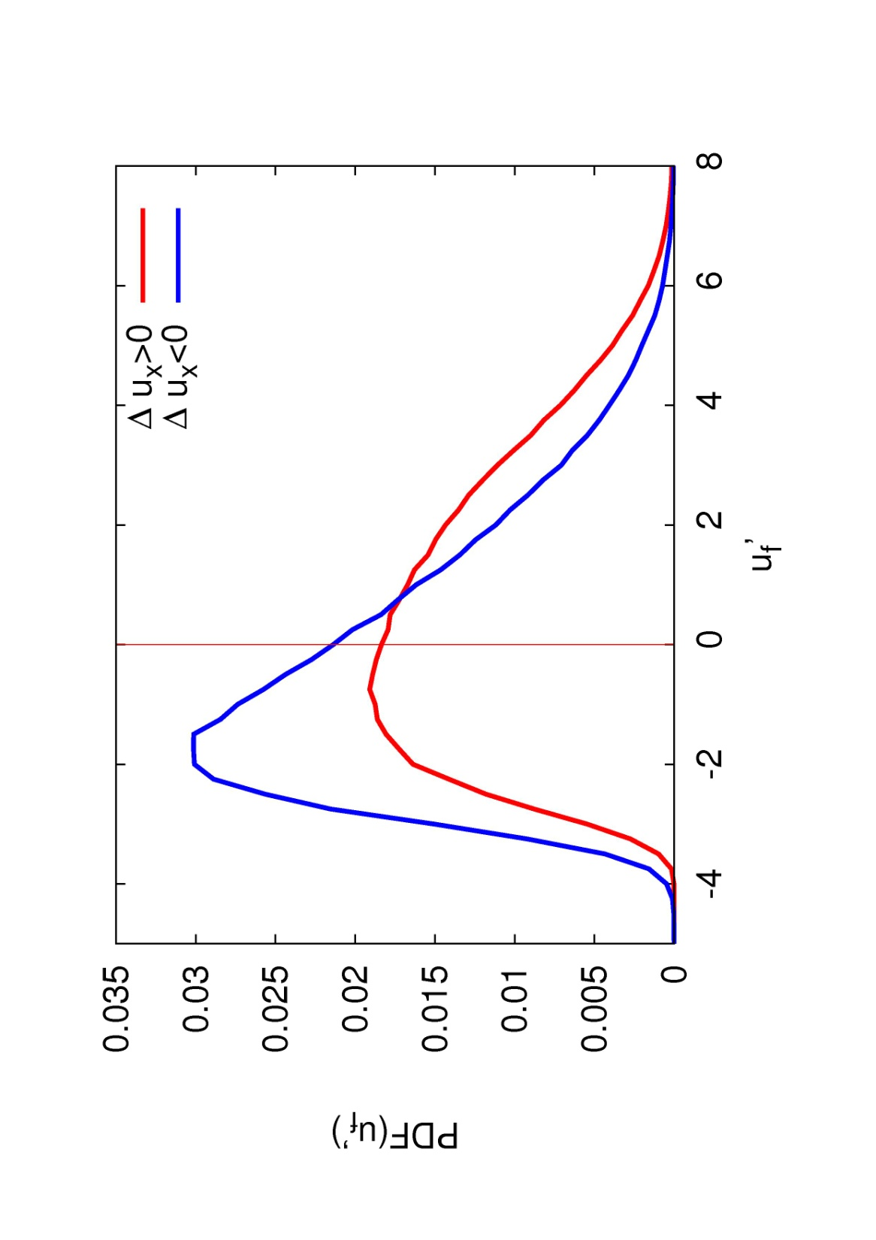
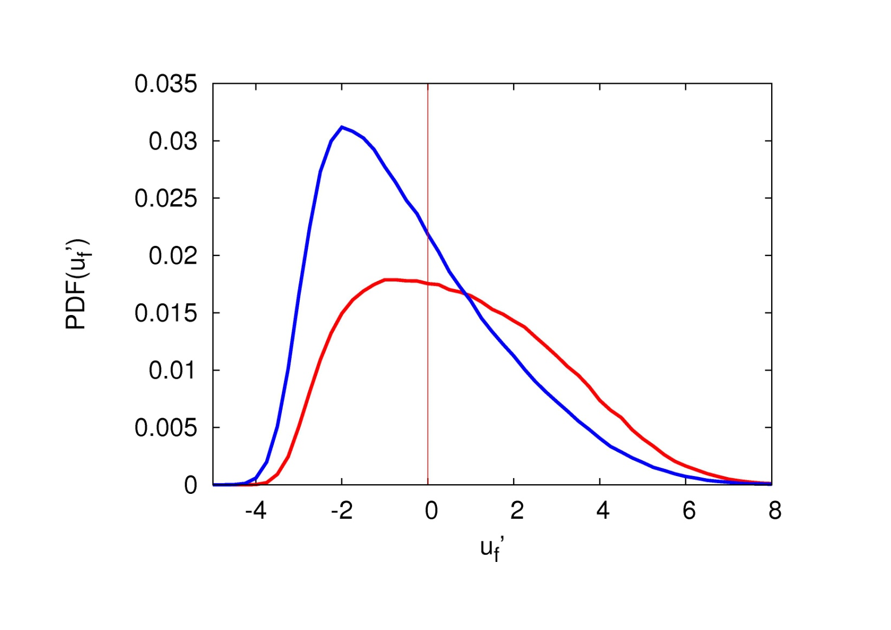
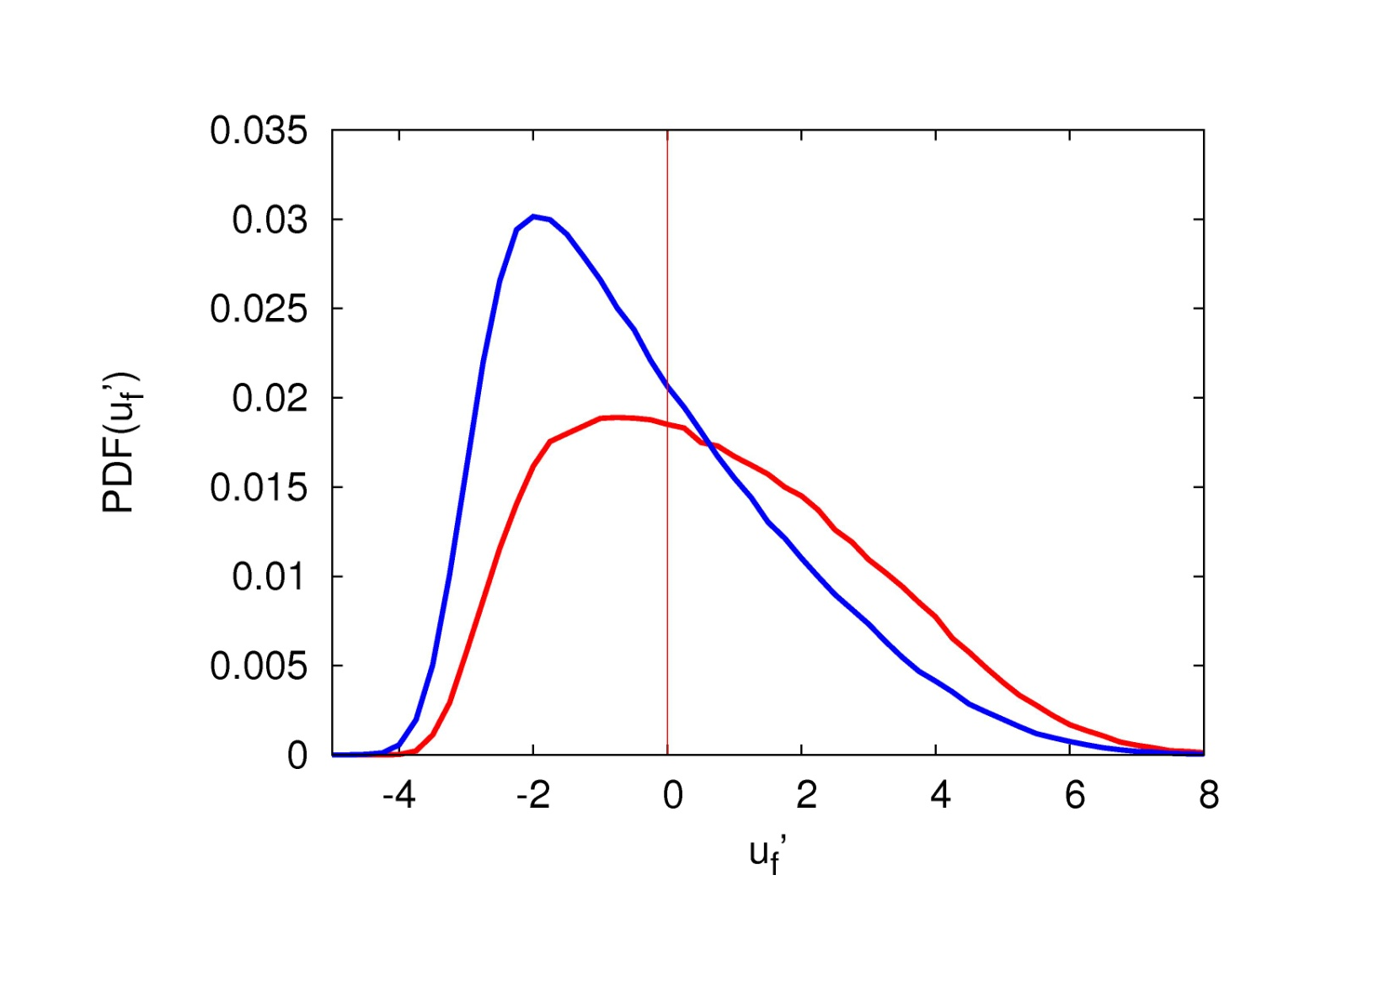
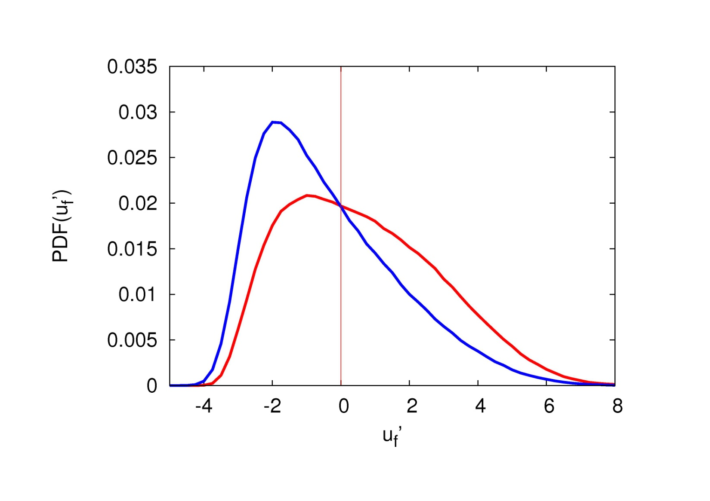
Results - Using Slip Velocity to Analyze
Fiber Accumulation in LSS
Effect of fiber elongation on conditioned PDF(u_{f}’) – St=30
λ=3
λ=10
λ=50
λ=1
Negative slip
Positive slip
The influence of λ is not dramatic: only a change in the
peak values is observed (no PDF shape change)

Slide 12
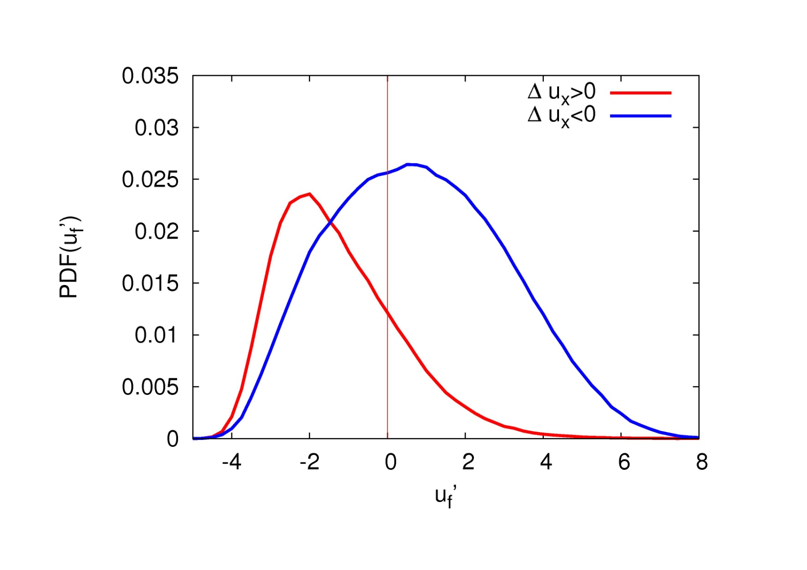
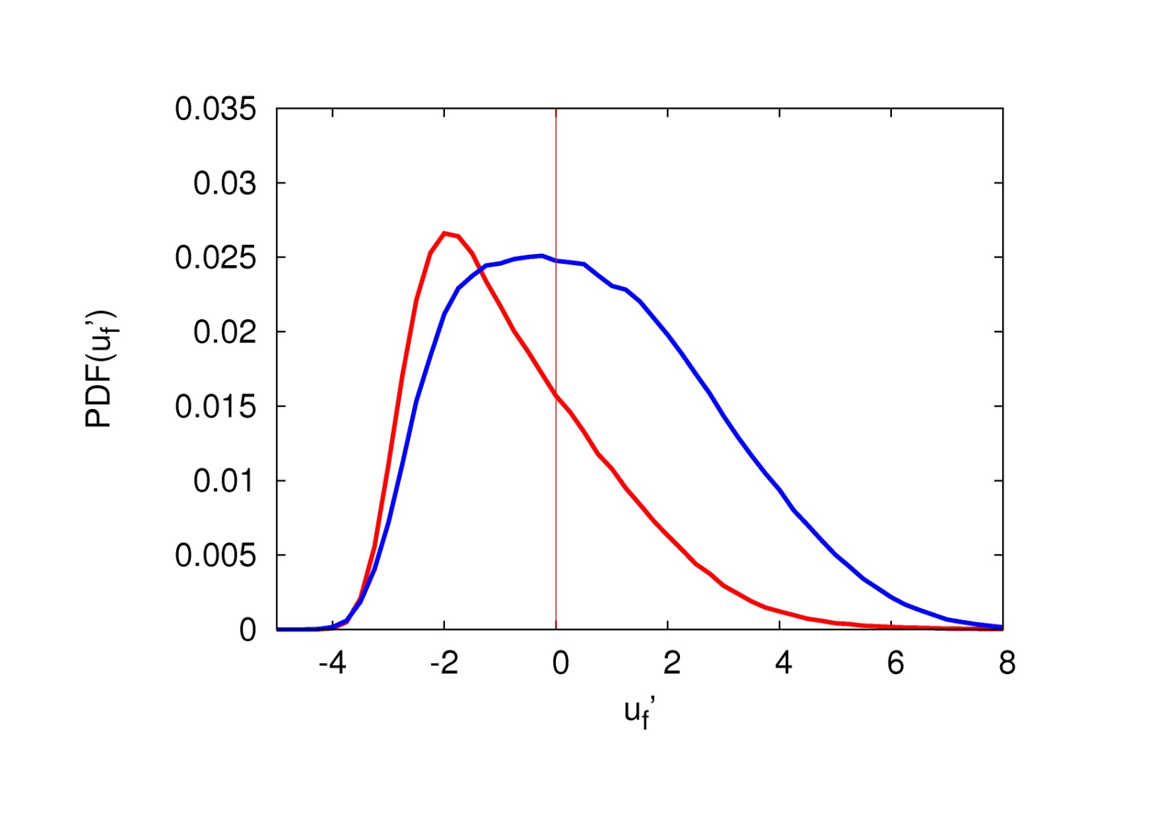
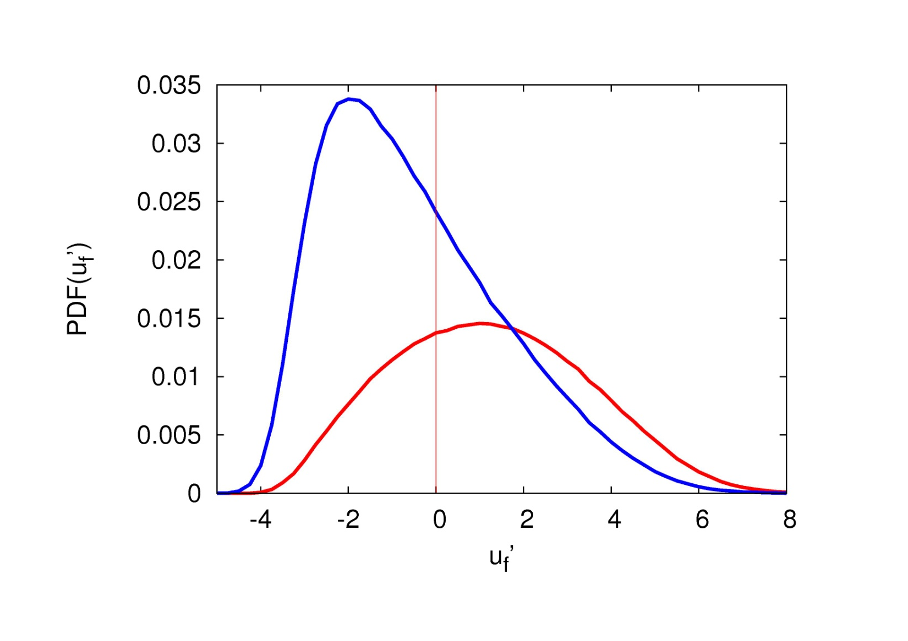
Results - Using Slip Velocity to Analyze
Fiber Accumulation in LSS
Effect of fiber inertia on conditioned PDF(u_{f}’)
St=5
St=30
St=100
St=1
Negative slip
Positive slip
Significant PDF shape change with curve “inversion”
between St=5 and St=30

Slide 13
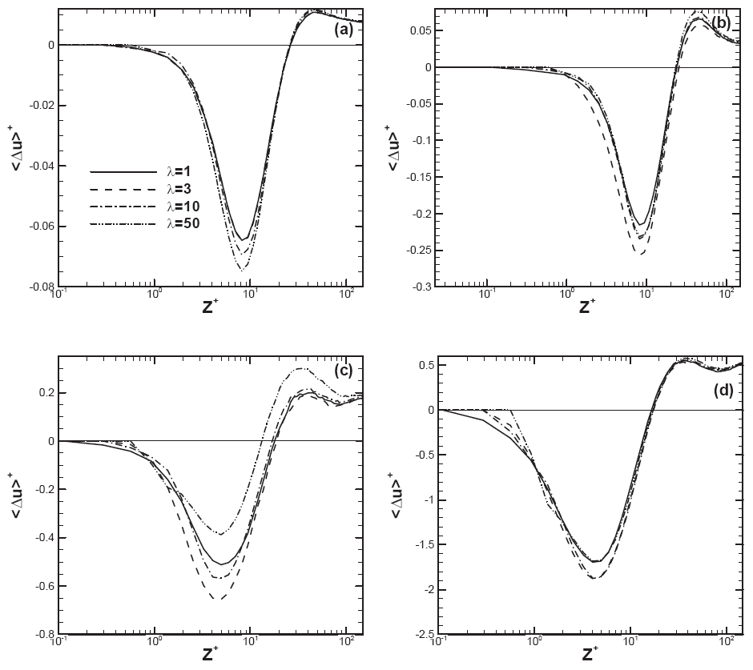
Results - Streamwise Slip Velocity:
Mean and RMS values
St=1
Mean RMS
St=30
Mean RMS

Slide 14
Results - Streamwise Slip Velocity:
Mean and RMS values
St=5
Mean RMS
St=100
Mean RMS

Slide 15
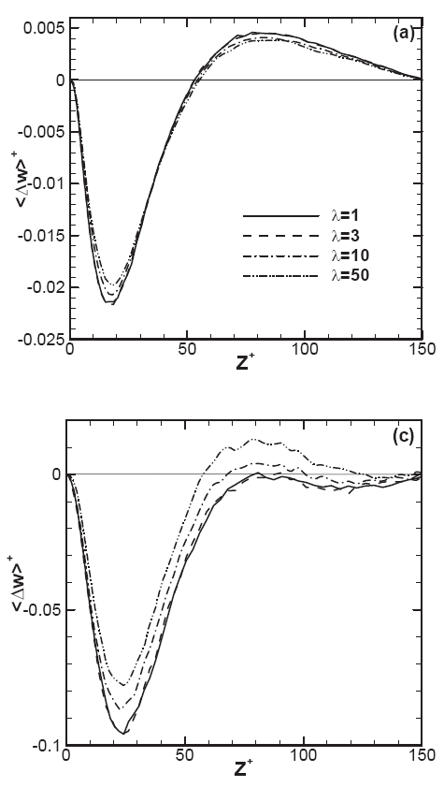
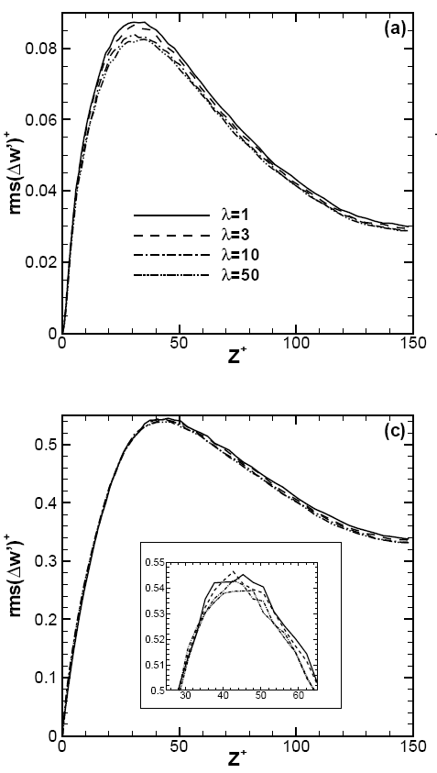
Results - Wall-Normal Slip Velocity:
Mean and RMS values
St=1
Mean RMS
St=30
Mean RMS

Slide 16
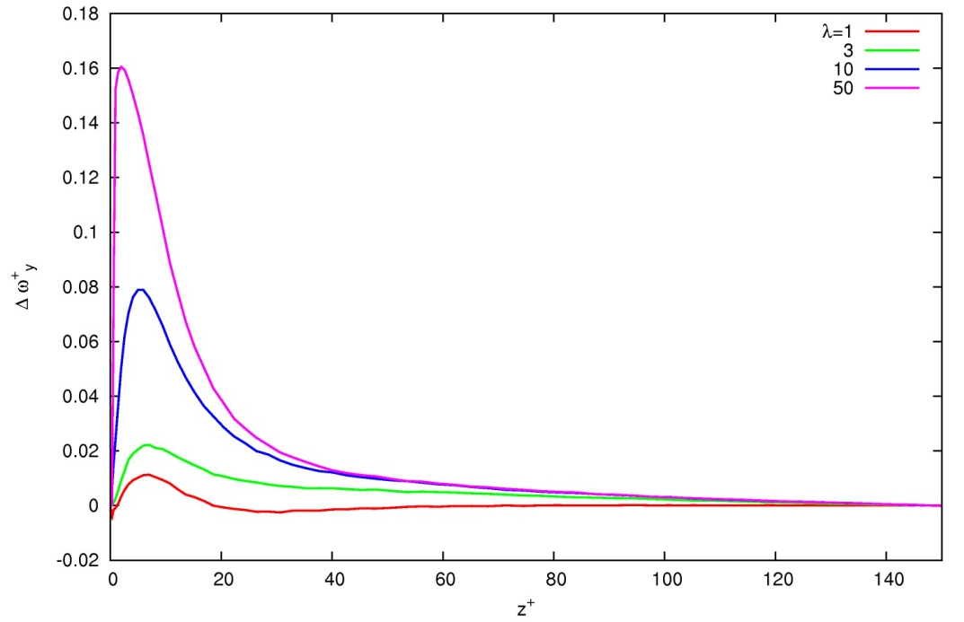
Conclusions …
…and Future Developments
Slip velocity is a useful measure of fibers-turbulence interaction in wall-bounded flows: its statistical characterization provides useful indications for modeling turbulent fiber dispersion
RMS exceeds the corresponding mean value by roughly 3 to 5 times: the instantaneous slip velocity may thus frequently change sign
Slip velocity statistics depend both on fiber elongation (quantitatively) and fiber inertia (also qualitatively!)
Simulate more values of St, λ and Re
Evaluate slip spin statistics
Mean slip spin for the St=30
fibers in the Re=150 flow
(spanwise component)
λ

