Slide 1

Characterization of fibers flow using EIT: results from Coimbra pilot rig
COST Action - FP1005
joint
4nd MC/WG Meeting
4th ERCOFTAC SIG43 Workshop
“Fibre suspension flow modelling - a key for innovation and competitiveness in the pulp & paper industry”
Pedro Faia
24-26 October, 2012, Throndeim, Norway
DEEC/FCT
University of Coimbra
Portugal

Slide 2
Presentation Outline
Characterization of fibers flow using EIT: results from Coimbra pilot rig.
Brief Introduction.
Electrical Impedance Tomography.
Mathematical formulation.
Fiber-flow Tomography first tests.

Slide 3
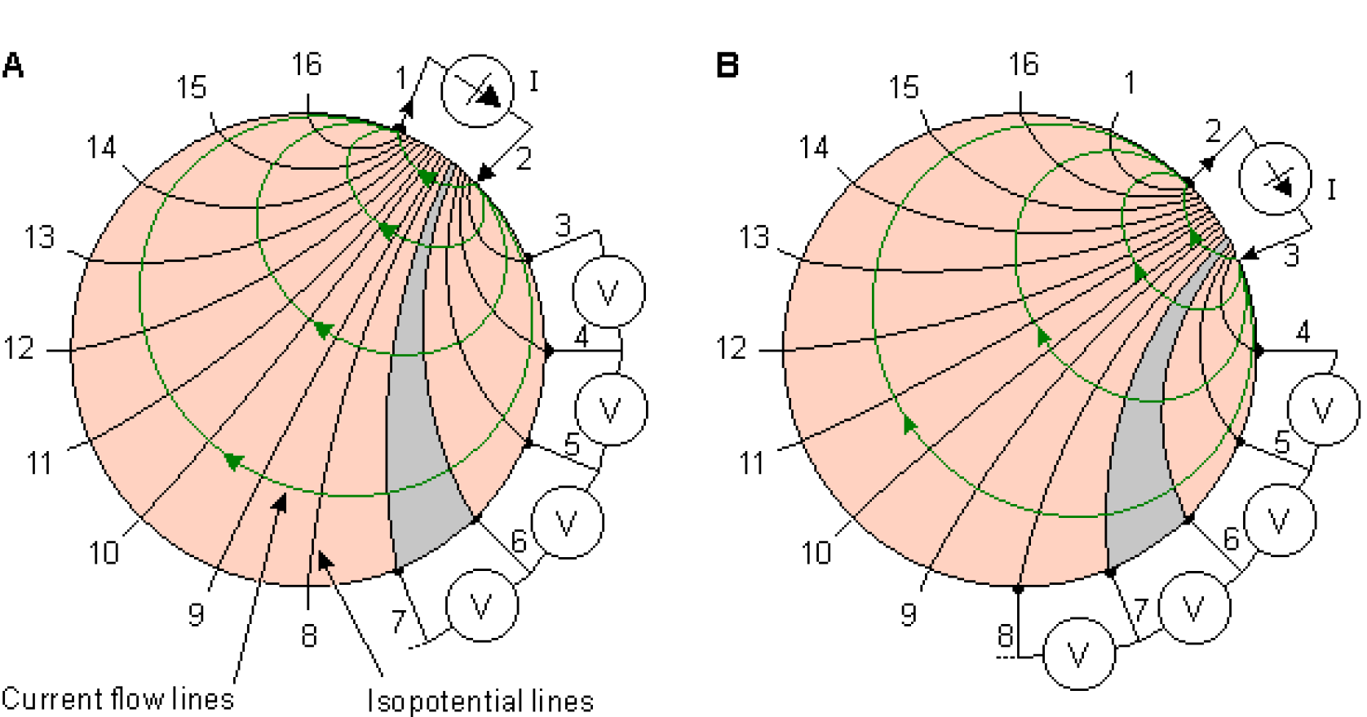
Characterization of fibers flow using EIT: results from Coimbra pilot rig.
Electrical Impedance Tomography overview
In the development of accurate models for suspension related processes, prior knowledge of several flow characteristics is essential, such as spatial distribution of phases, flow regimen, interfacial area, and relative velocity between phases, amongst others.

Slide 4
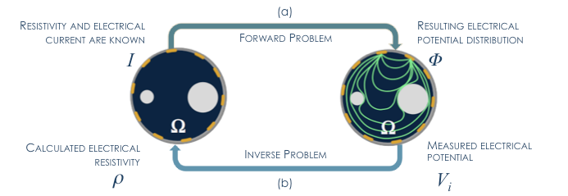
Characterization of fibers flow using EIT: results from Coimbra pilot rig.
Mathematical Formulation
Complete Electrode Model (CEM)
Regularized Gauss-Newton algorithm

Slide 5
Characterization of fibers flow using EIT: results from Coimbra pilot rig.
PILOT RIG overview

Slide 6
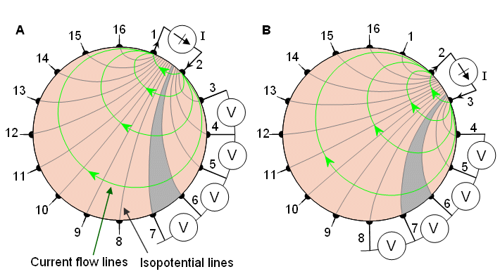
Characterization of fibers flow using EIT: results from Coimbra pilot rig.
EIT data protocols
Adjacent injection and measuring

Slide 7
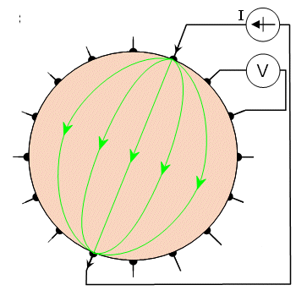
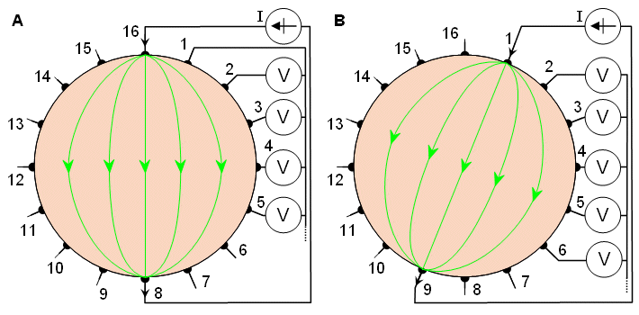
Characterization of fibers flow using EIT: results from Coimbra pilot rig.
EIT data protocols
Oposite injection and adjacent measuring
data collection experimental procedure
data collection
typical procedure

Slide 8
Characterization of fibers flow using EIT: results from Coimbra pilot rig.
Some sensitivity results
For all described tests a mesh with 2304 triângular elements and 1201 nodes was used (other parameters: contact impedance considered : 0,67 Ohm; applied injected current amplitude : 0,36 mA)
Majourly Oposite injection and adjacent measuring was used;
For the flow rate 0 m³/h, Adjacent injection and measuring was used instead;
For the tests depicted, Eucaliptus short fibers, with a lenght of 0,706±0,03 mm, and with a concentration of ± 0.159 % (m/m) were used;

Slide 9
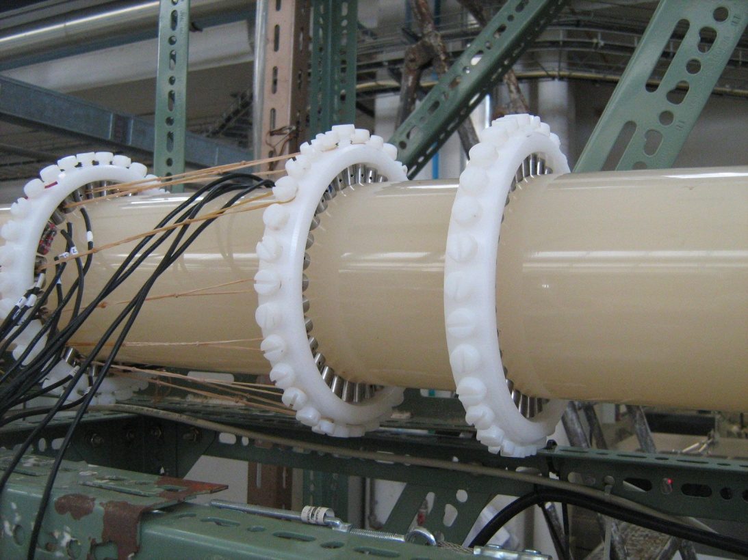
Characterization of fibers flow using EIT: results from Coimbra pilot rig.
Constant flow testing
Two medium were used as references for the first tests: industrial water and water, both with similar conductivity 1197 mS (at 35 Cº); Inside rig section of 0.157 m².
 | Exp 1 | Exp 2 | Exp 3 | Exp 4 | Exp 5 | Exp 6
Flow (m³/h) | 3,75 | 28,4 | 41,4 | 51,5 | 72 | 83,7
Temperature (ºC) | 28,3 | 29 | 29,5 | 30 | 30,3 | 31
Dif. Pressure (mm.H₂O) | 4 | 61 | 124 | 189 | 364 | 488
Velocity (m/s) | 0,13 | 1,005 | 1,46 | 1,82 | 2,55 | 2,96

Slide 10
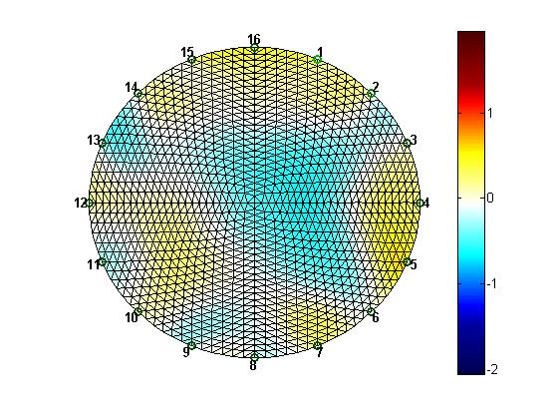
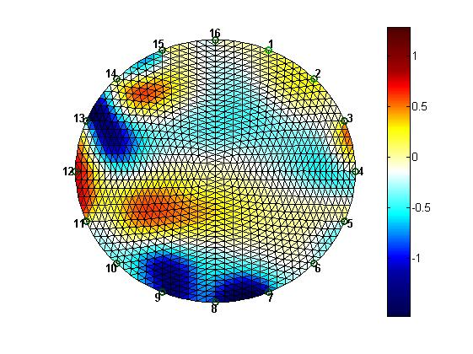
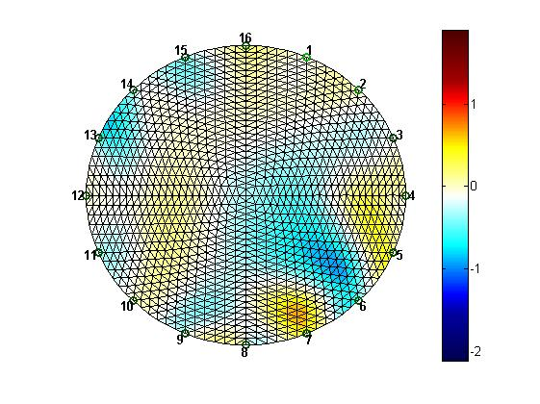
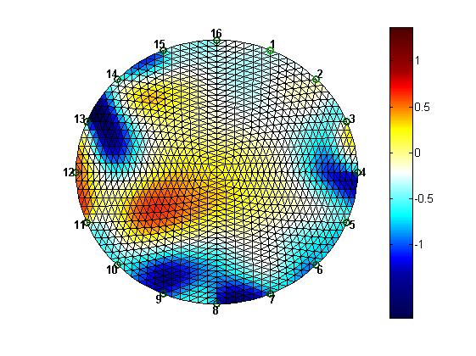
Characterization of fibers flow using EIT: results from Coimbra pilot rig.
Constant flow testing
Industrial water
3,75 (m³/h)
Water
Industrial water
28,4 (m³/h)
Water

Slide 11
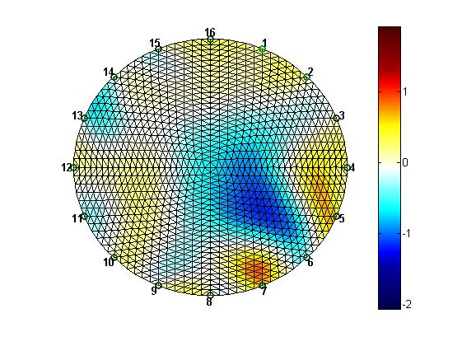
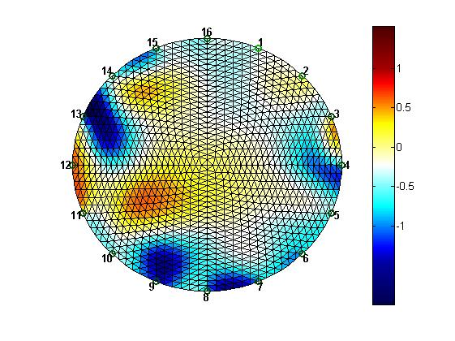
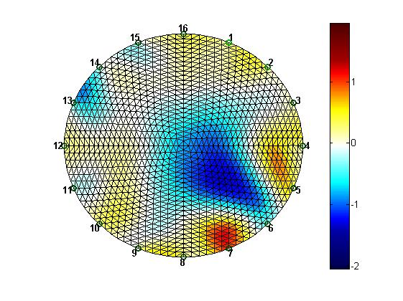
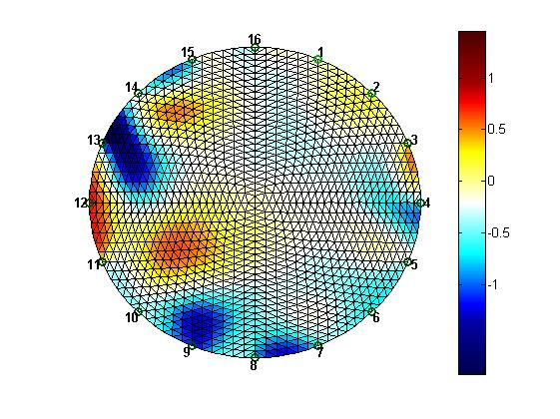
Characterization of fibers flow using EIT: results from Coimbra pilot rig.
Constant flow testing
Industrial water
41,4 (m³/h)
Water
Industrial water
51,5 (m³/h)
Water

Slide 12
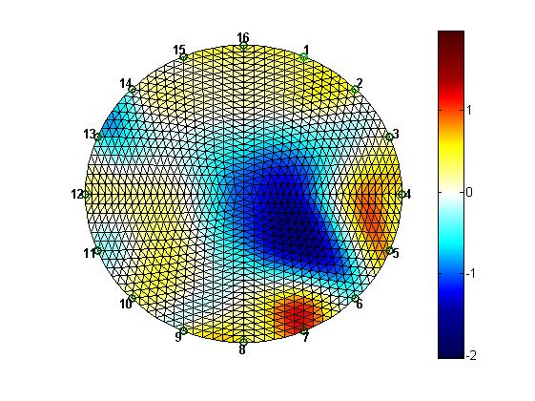
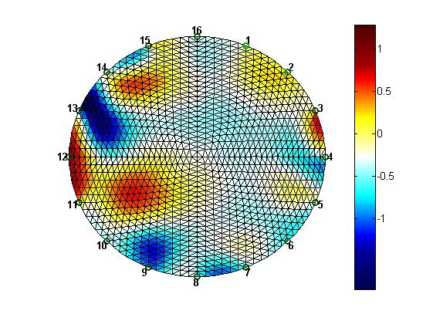
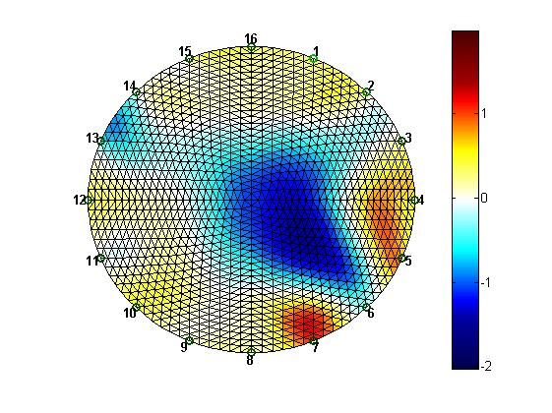
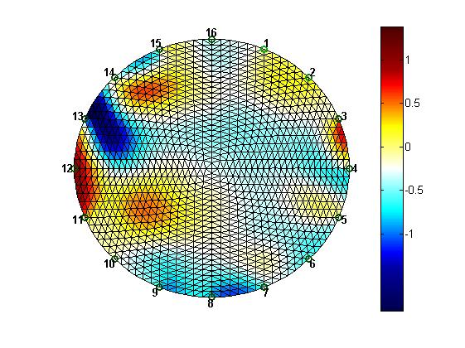
Characterization of fibers flow using EIT: results from Coimbra pilot rig.
Constant flow testing
Industrial water
72 (m³/h)
Water
Industrial water
83,7 (m³/h)
Water

Slide 13
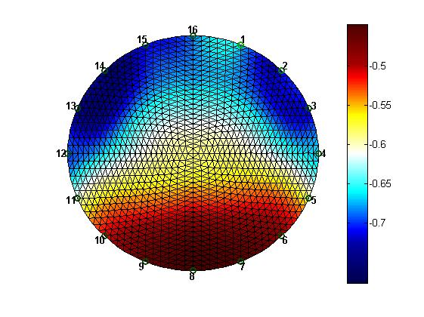
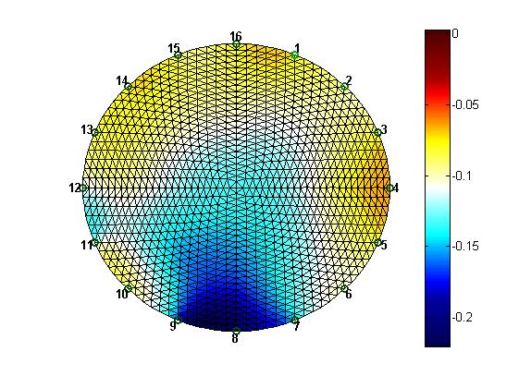
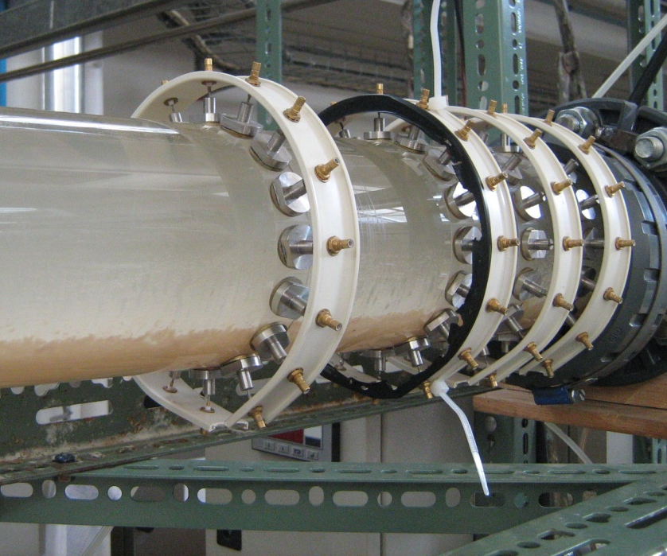
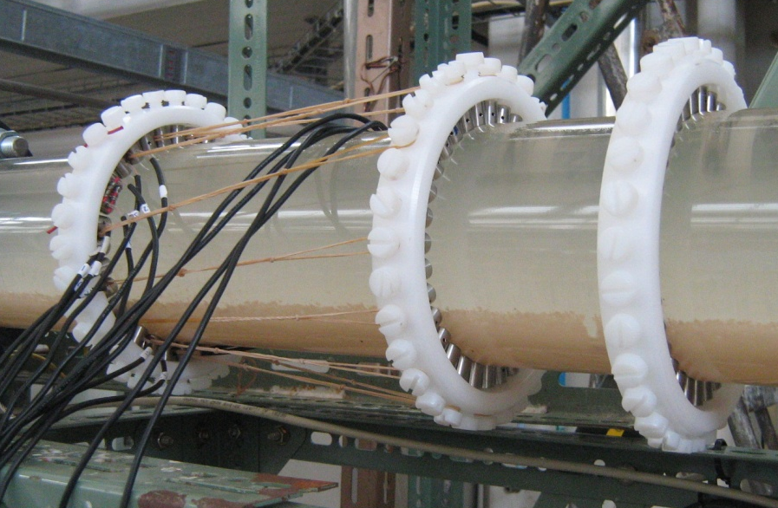
Characterization of fibers flow using EIT: results from Coimbra pilot rig.
Electrodes material comparison
Stainless stell
0 (m³/h)
Titanium
Flow rate: 0 m³/h. Reference medium :water

Slide 14
Characterization of fibers flow using EIT: results from Coimbra pilot rig.
Next steps
New batch’s of eucaliptus fibers with concentrations up to 3-4% will be used.
Other type of fibers, for instance pine, will be tested.

Slide 15
Thank you for you attention
Characterization of fibers flow using EIT: results from Coimbra pilot rig.

